Slide 1
Notes:
Native Plant Gardening in Southeastern Colorado
Introduction

Slide 2
Notes:
Why use native plants?
Personal Gains
Lower Water Use
Prevents erosion
Less soil amendments
Less maintenance
Ecological Gains
Creating habitat for wildlife
Less fragmentation of ecosystems
Carbon sequestration

Slide 3
Notes:
Why use native plants?
Water Conservation
Turfgrass Water Use
50% of household water is used for lawns and landscapes
9 billion gallons of water used each day in the US for outdoor watering
Watering one acre with one inch of water amounts to 27,176 gallons which totals 815,280 gallons in a year (May-November)
Native buffalograss lawns only need 8-10 inches of water per year to survive and it only grows 4-8 inches tall so can go unmowed

Slide 4
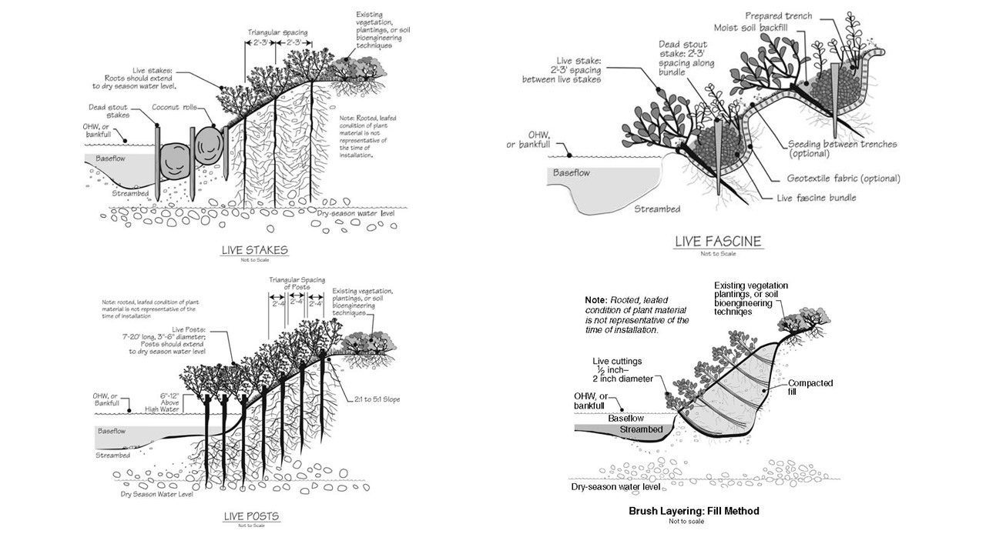
Notes:
Why use native plants?
Erosion Control
US Forest Service Methods for Streambanks
Live Stakes
Live Fascine
Live Posts
Brush Layering

Slide 5
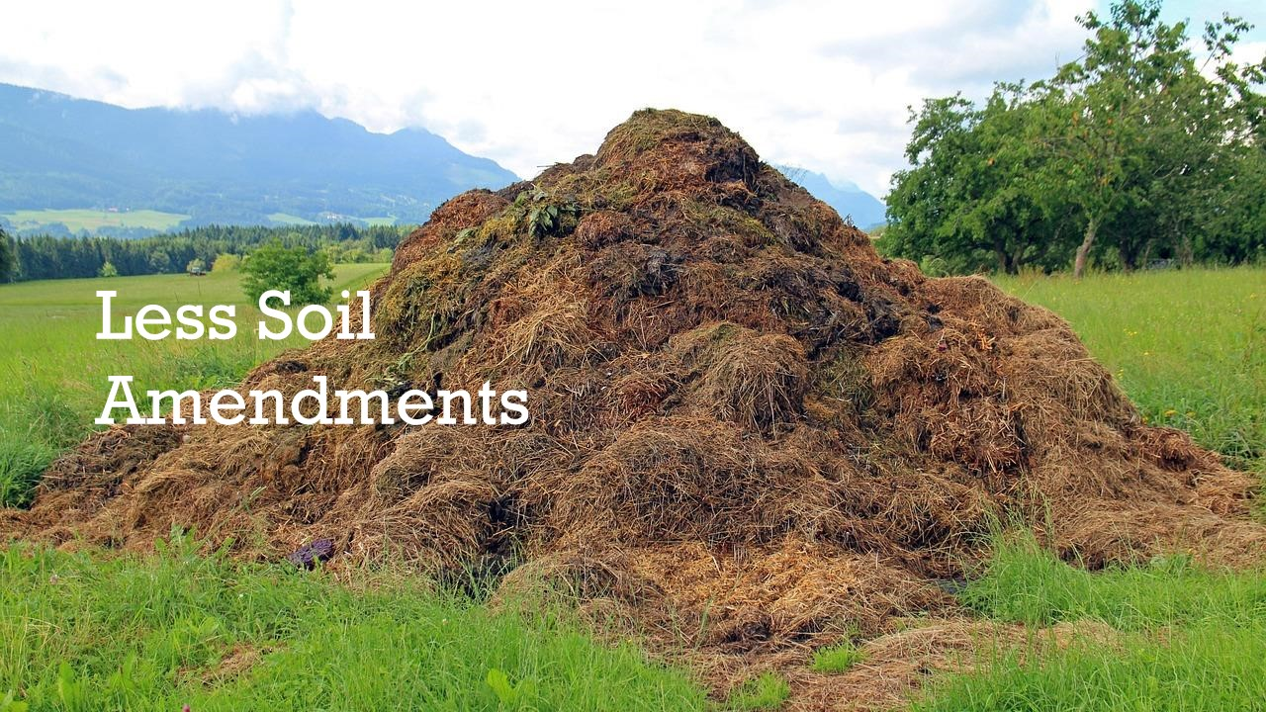
Notes:
Why use native plants?
Less Soil Amendments
No need to amend soils or add fertilizers
Native plants evolved with these soils

Slide 6
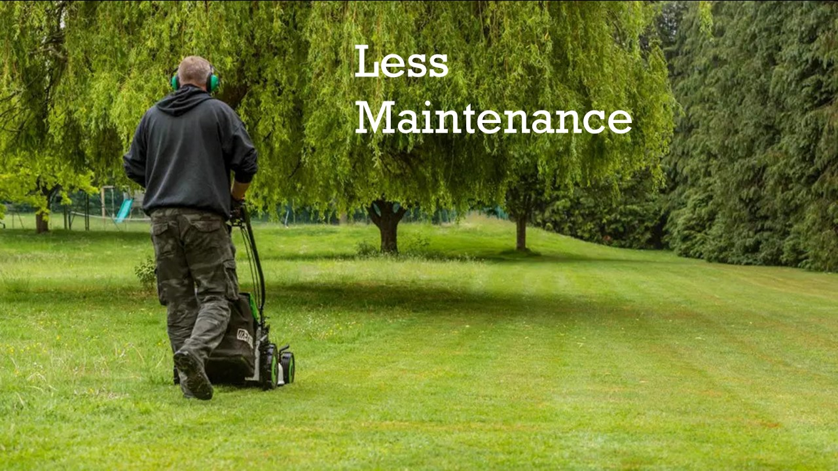
Notes:
Why use native plants?
Less Maintenance
No mowing
No or less watering
Dense plantings block weeds effectively

Slide 7
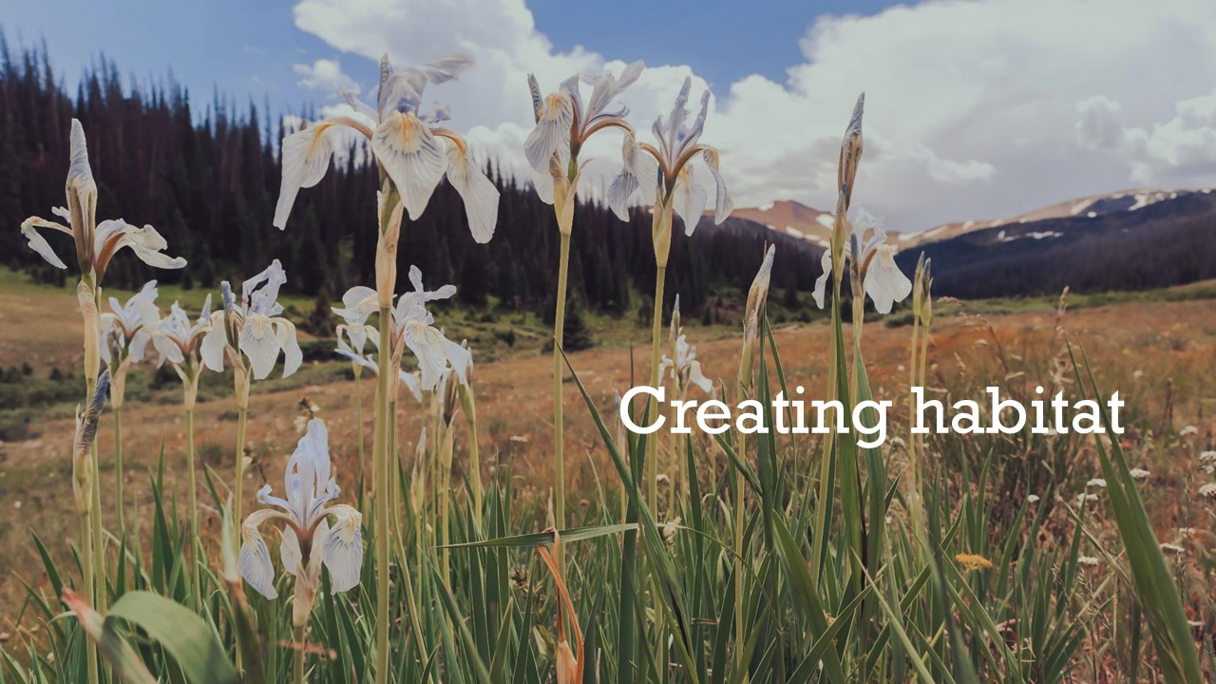
Notes:
Why use native plants?
Creating habitat
Planting native plants helps create vital habitat by providing food, shelter, and breeding space for local wildlife. These plants have evolved alongside native insects, birds, and animals, supporting complex ecological relationships that non-native ornamentals cannot.
By choosing natives, we can turn our yards into thriving ecosystems that support pollinators, songbirds, and other essential species.
To truly embrace this change, we must rethink what a garden is for—and what it means to be beautiful. Instead of manicured lawns and exotic blooms, imagine vibrant patches of wildflowers buzzing with bees, seedheads feeding birds, and the subtle, seasonal rhythm of a living landscape. A garden can be more than decoration—it can be part of something larger.

Slide 8
Notes:
Why use native plants?
Creating Habitat
Soil Food Web
Plants are part of the first level of the food chain

Slide 9
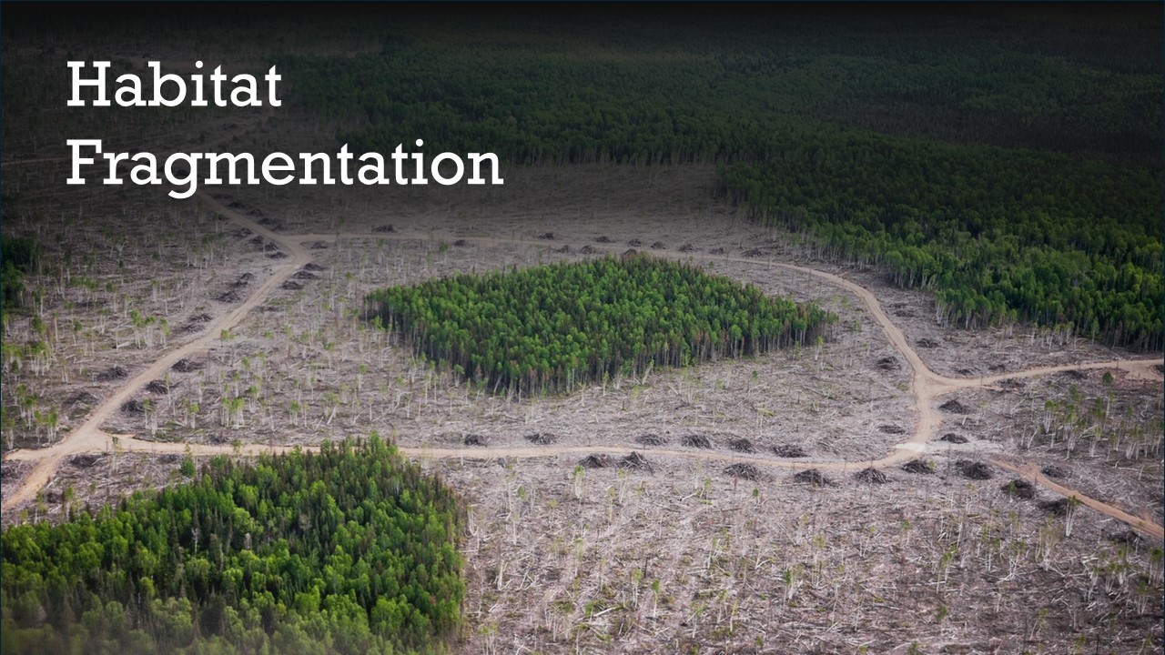
Notes:
Why use native plants?
Creating Habitat
Habitat Fragmentation
Habitat fragmentation is the process by which large, continuous habitats are broken into smaller, isolated patches, often due to human activities like urban development, agriculture, roads, and infrastructure.
This fragmentation can have serious ecological consequences:
Loss of biodiversity: Smaller, isolated habitats support fewer species and make it harder for wildlife to survive and reproduce.
Disrupted migration and movement: Animals may be unable to access food, mates, or seasonal habitats.
How we can help?
Creating pockets of natural ecosystems in our yards to reduce fragmentation

Slide 10
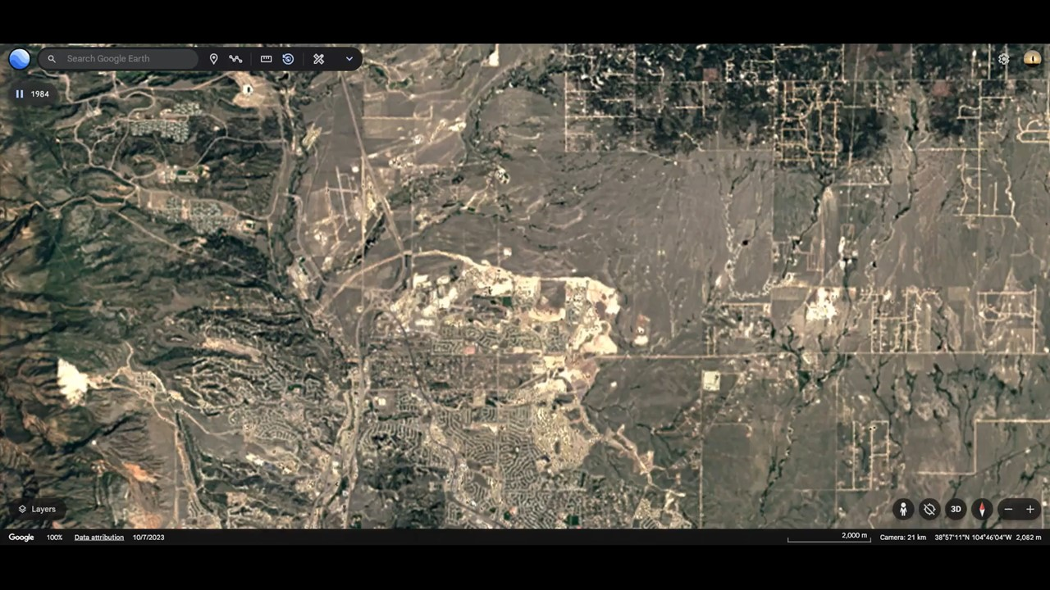
Notes:
Why use native plants?
Habitat Fragmentation
City Sprawl
Colorado Springs Timelapse 1984-2022
Approximately 50% of The Shortgrass Prairie remains uncultivated
The area of developed land in Colorado grew from 1.2 million acres in 1982 to 2 million acres in 2017, an increase of about 800,000 acres. El Paso County, where Colorado Springs sits lost 112,000 acres of open space, the most of any county in the state in just 35 years.

Slide 11
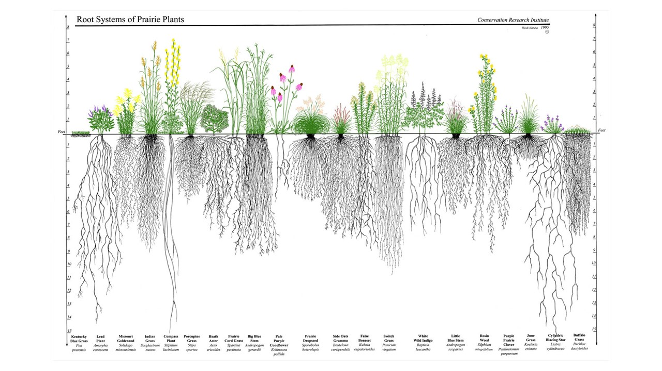
Notes:
Why use native plants?
Carbon Sequestration
Root Systems of Prairie Plants
Deep roots store carbon
Shortgrass prairies may not store as much above-ground carbon as forests, but they can store large amounts of carbon in the soil for centuries, making them crucial for climate mitigation and ecosystem resilience.

Slide 12
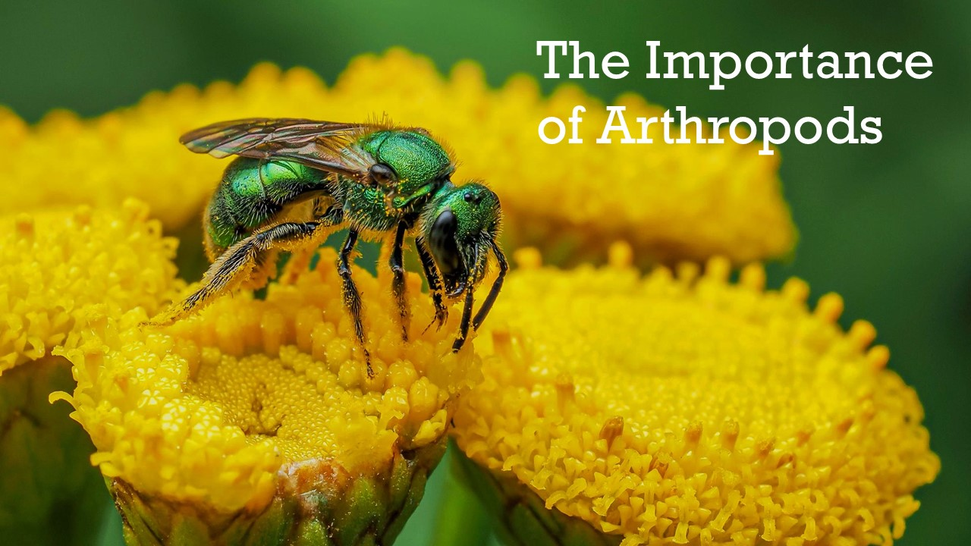
Notes:
The Importance of Arthropods
Augochlorella aurata - Golden Sweat Bee
Plants and insects coevolved and depend on each other
Plants very often need specialist insects to pollinate them
Insects often require specific host plants to raise their young
Plants feed insects which then feed larger animals like birds, reptiles and mammals

Slide 13
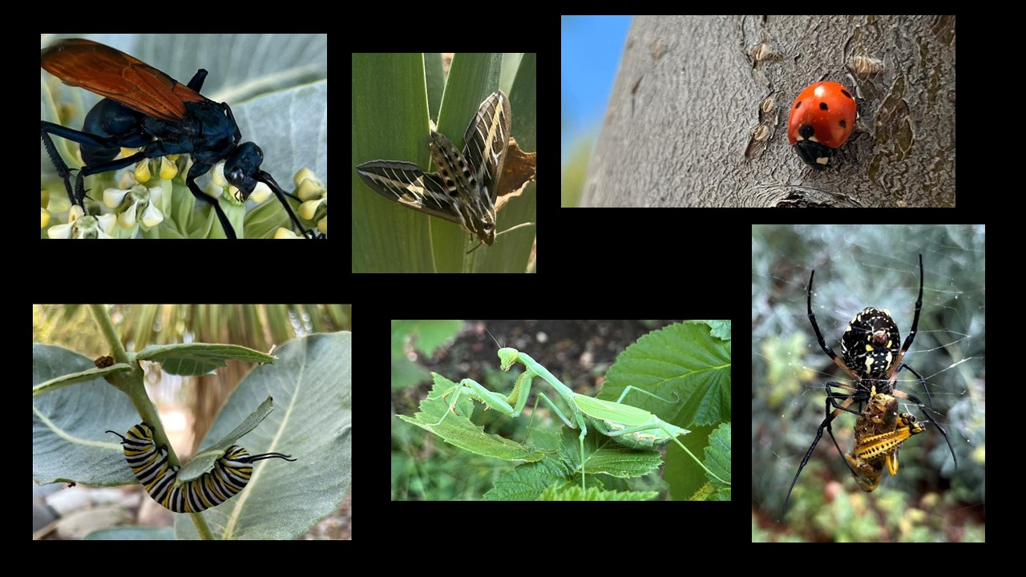
Notes:
The Importance of Arthropods
Arthropods of the garden (1 of 2)

Slide 14
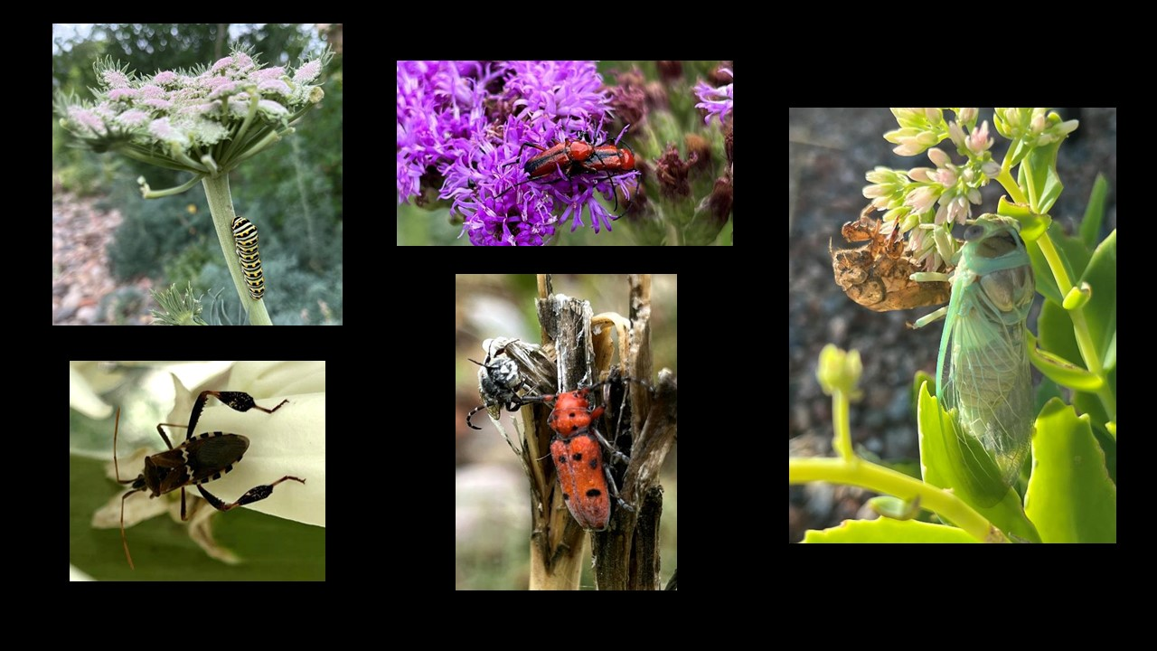
Notes:
The Importance of Arthropods
Arthropods of the garden (2 of 2)

Slide 15
Notes:
The Importance of Arthropods
Native Bees
Hunt’s Bumblebee
About 20%-45% of native bees are pollen specialists, meaning that they use only pollen from one species (or genus) of plants. If that plant is removed, the bee goes away. If bees are removed, the plant doesn't reproduce. Some of the native bees are specialists on the very plants that we use for food, including squashes, pumpkins, gourds, and the annual sunflower.

Slide 16
Notes:
The Importance of Arthropods
Native Wasps
Thisbe's Tarantula-hawk Wasp
Native wasps play a crucial role in ecosystems by controlling insect populations such as caterpillars, aphids and even spiders to feed their young.
Many native wasps also visit flowers for nectar, helping to pollinate plants.

Slide 17
Notes:
The Importance of Arthropods
Butterflies
Monarch Butterfly
Butterflies use specific host plants to feed their young, making them essential for the growth and survival of the next generation.
They are a food source for birds, spiders, lizards, mice and other animals.
If butterfly populations diminish, the impact will be felt higher up and can affect the entire ecosystem.

Slide 18
Notes:
The Importance of Arthropods
Moths
Glover’s Silkmoth
Moths are nocturnal pollinators, visiting flowers that bloom or release scent at night and ensuring the reproduction of many plant species.
Their activity complements that of daytime pollinators like bees, helping to support healthy ecosystems.
Moths, like butterflies are also a food source for other animals.

Slide 19
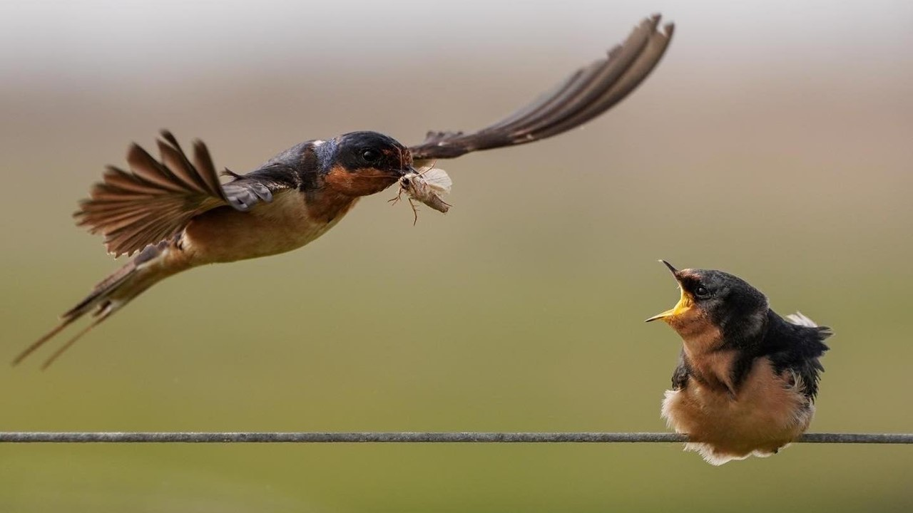
Notes:
The Importance of Arthropods
Barn Swallow delivering food (an insect)
Douglas Tallamy observed a Chickadee nest in his yard: “It takes 350 to 570 caterpillars every day to feed a clutch of chickadees, depending on how many nestlings they have. So, an incredible 6,000 to 9,000 caterpillars are required to make one clutch of chickadees.”

Slide 20
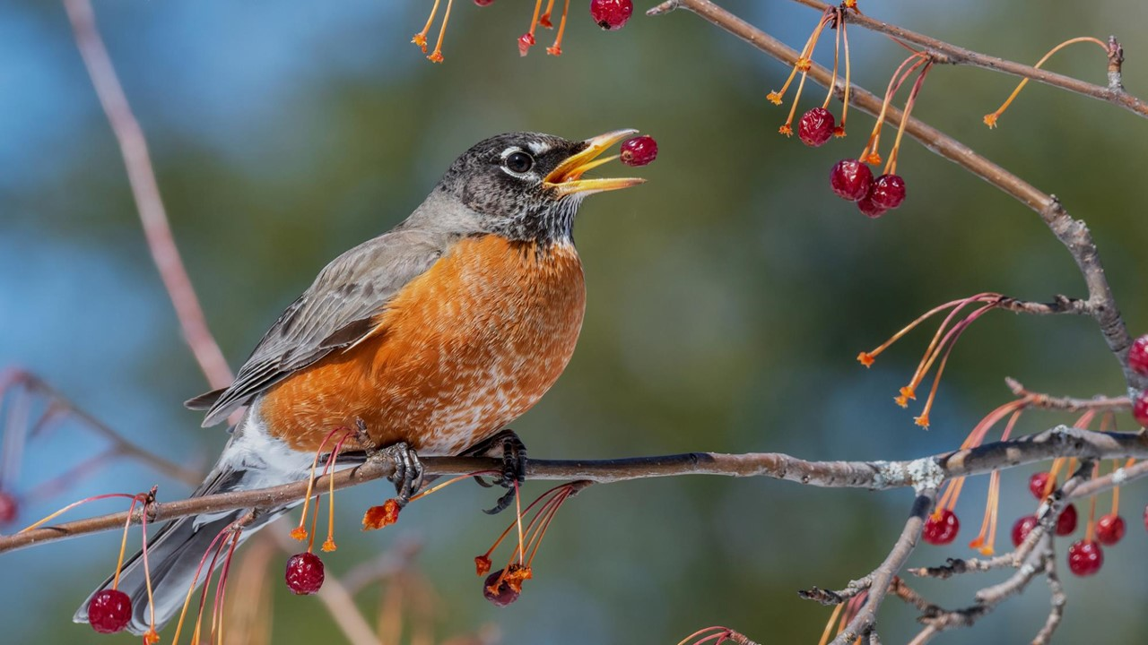
Notes:
The Importance of Arthropods
American Robin eating fruit in winter

Slide 21
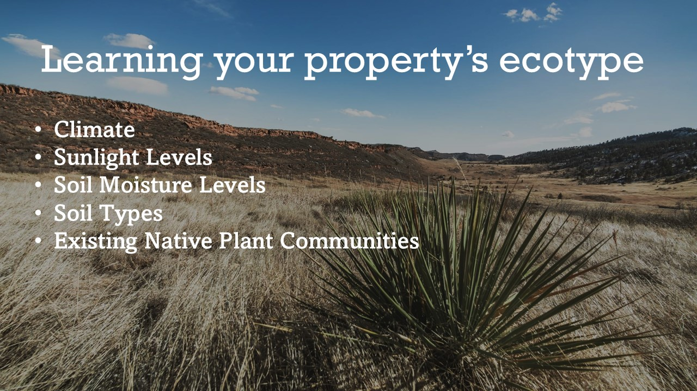
Notes:
Learning your property’s ecotype
Climate
Sunlight Levels
Soil Moisture Levels
Soil Types
Existing Native Plant Communities
It is important to know these things to ensure success of a new native garden

Slide 22
Notes:
Learning your property’s ecotype
Climate
What constitutes climate?
Temperature, Humidity, Precipitation, Wind, Sunlight, Atmospheric Pressure, Seasonal Variation, Extreme Weather Patterns and Long-Term Averages.
SE Colorado is classified as BSk: Cold Semi-Arid
Pueblo gets an average of 10-12 inches of precipitation, has low humidity, with hot summers and cold winters

Slide 23
Notes:
Learning your property’s ecotype
Climate
CSU Extension Climate Summary for Pueblo, Colorado
Average Monthly Temperatures
Average Monthly Precipitation
Frost Probabilities
Typical Water Requirement for Colorado Lawns

Slide 24
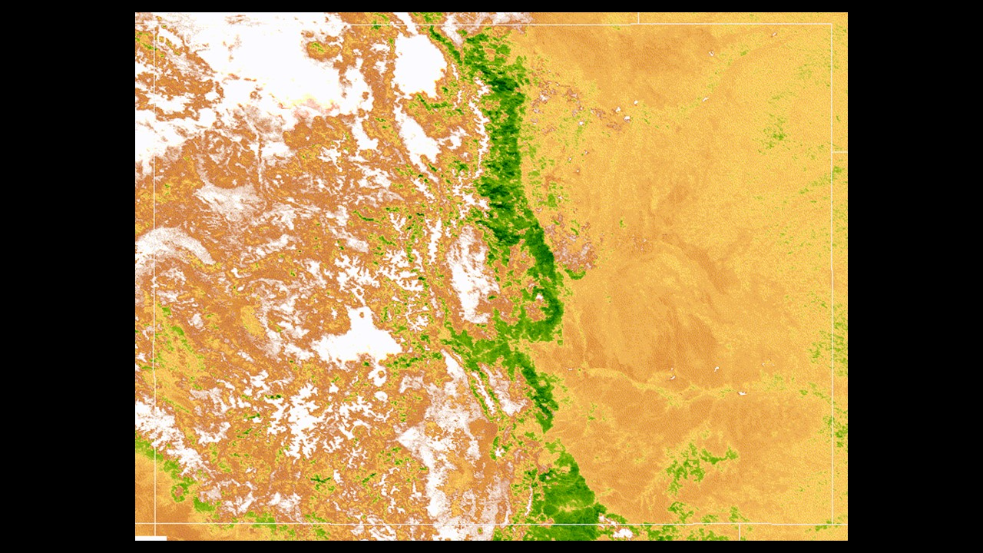
Notes:
Learning your property’s ecotype
Climate
Satellite Timelapse of Colorado over 1 year
Shows how SE Colorado is more arid than other parts of the state

Slide 25
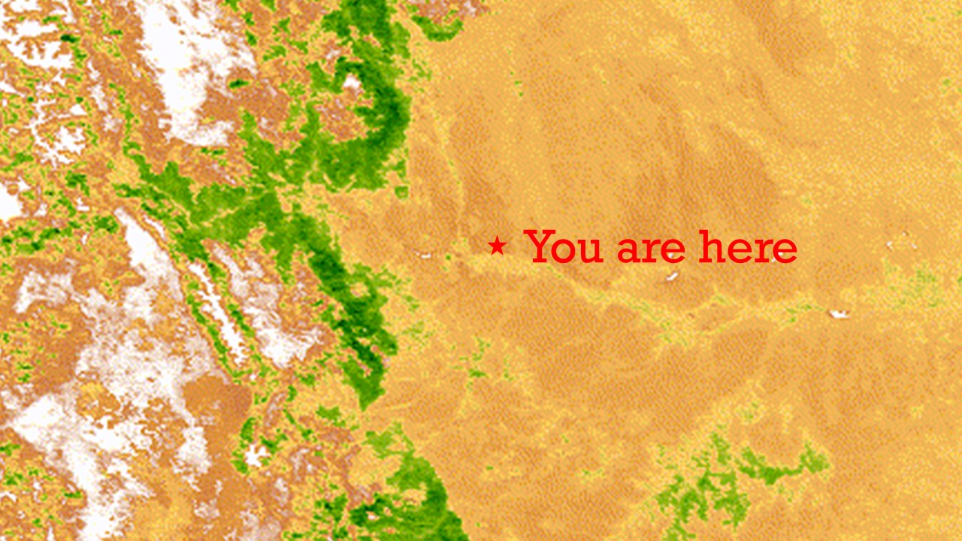
Notes:
Learning your property’s ecotype
Climate
Zoomed Satellite Timelapse focusing on SE Colorado
Shows how riparian corridor of the Arkansas River is wetter than the surrounding valley

Slide 26
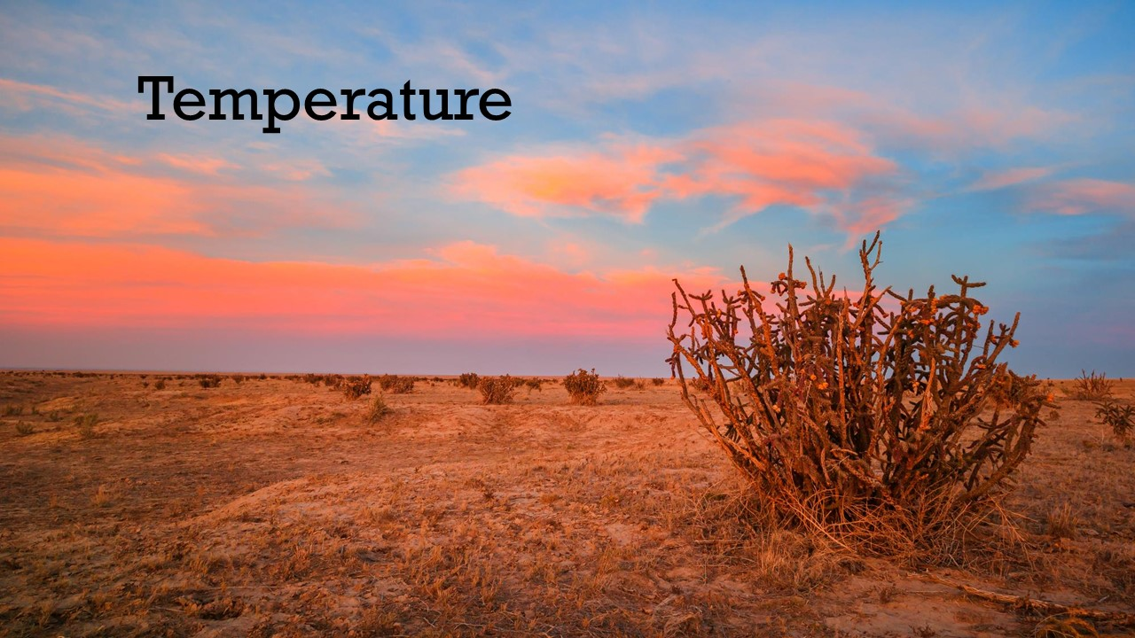
Notes:
Learning your property’s ecotype
Climate
Temperature

Slide 27
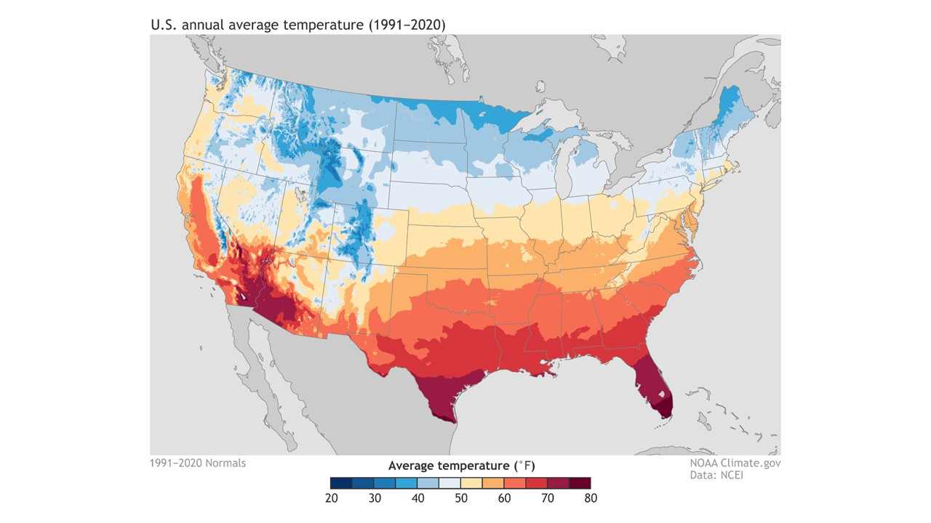
Notes:
Learning your property’s ecotype
Climate
Temperature
US Annual Average Temperature Map
SE Colorado listed as 50-55

Slide 28
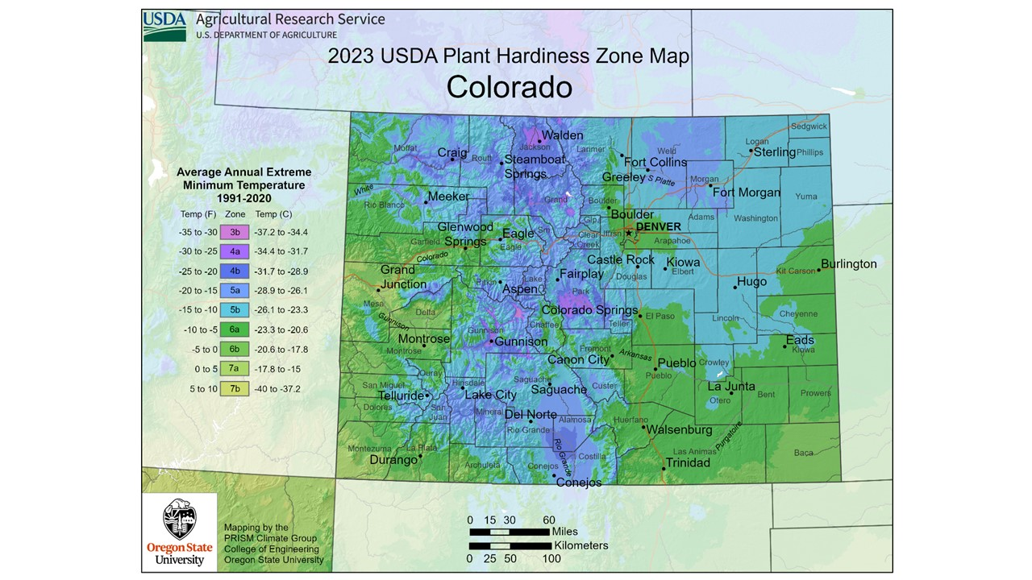
Notes:
Learning your property’s ecotype
Climate
Temperature
2023 USDA Hardiness Zone Map
Pueblo listed as Zone 6a (lowest temperature being -10 to -5 F)
2012 version listed Pueblo as Zone 5b (lowest temperature being -15 to -10 F)
Rising temperatures due to climate change

Slide 29
Notes:
Learning your property’s ecotype
Climate
Precipitation

Slide 30
Notes:
Learning your property’s ecotype
Climate
Precipitation
The Water Cycle
Precipitation, Snow Melt, Surface Flow, Infiltration, Groundwater Flow, Plant Uptake
Evaporation, Condensation and Repeat

Slide 31
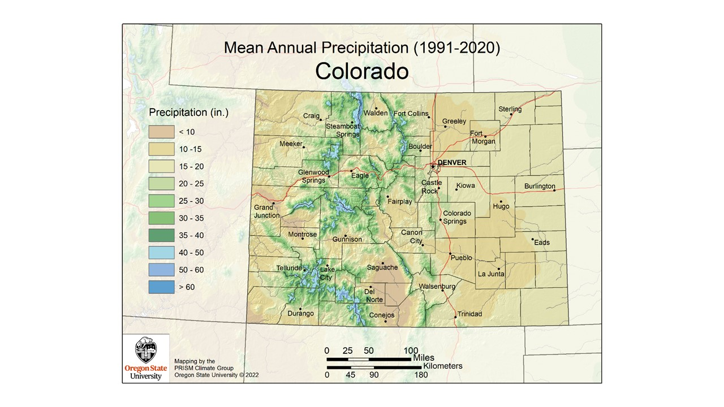
Notes:
Learning your property’s ecotype
Climate
Precipitation
Mean Annual Precipitation for Colorado (1991-2020)
Pueblo is listed at 10-15 inches

Slide 32
Notes:
Learning your property’s ecotype
Climate
Sunlight Levels
Plants have different sun needs based on how they evolved and where they grow naturally
Native shortgrass prairie plants are nearly all full sun
Partial sun and full shade areas can be planted with riparian understory plants or woodland plants from the foothills

Slide 33
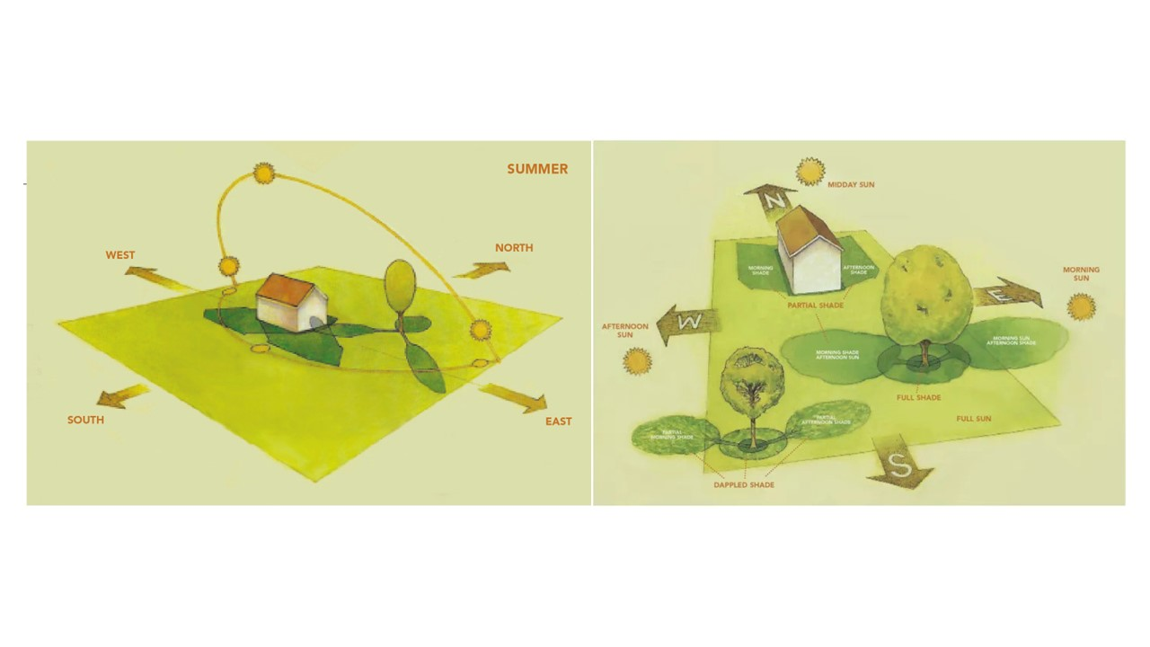
Notes:
Learning your property’s ecotype
Climate
Sunlight Levels
Examining how the sun and shadows move across your property will help when selecting plants. You can see this in nature especially in the mountain areas by comparing plants on South and North slopes.
North facing slopes often have more Spruce, Fir and Aspen
South facing slopes might have Ponderosa Pines, Juniper or Chaparral
Tracking the sun across your property
South facing always the highest sun levels and driest soils
North facing is mostly shaded and soil holds moisture longer
Account for how trees and structures cast shade

Slide 34
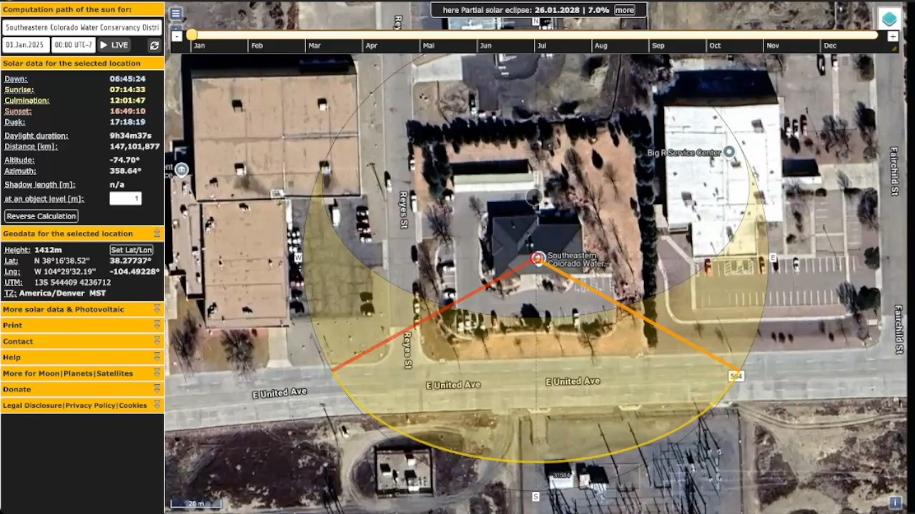
Notes:
Learning your property’s ecotype
Climate
Sunlight Levels
Suncalc.org
Tool that shows sunrise, sunset and the changing arc of the sun throughout the year
In Summer the sun is higher north and in Winter is further South

Slide 35
Notes:
Learning your property’s ecotype
Soil Moisture Levels
Influenced by topography and influences plant communities
Photo shows riparian plant communities transitioning to upland plant communities

Slide 36
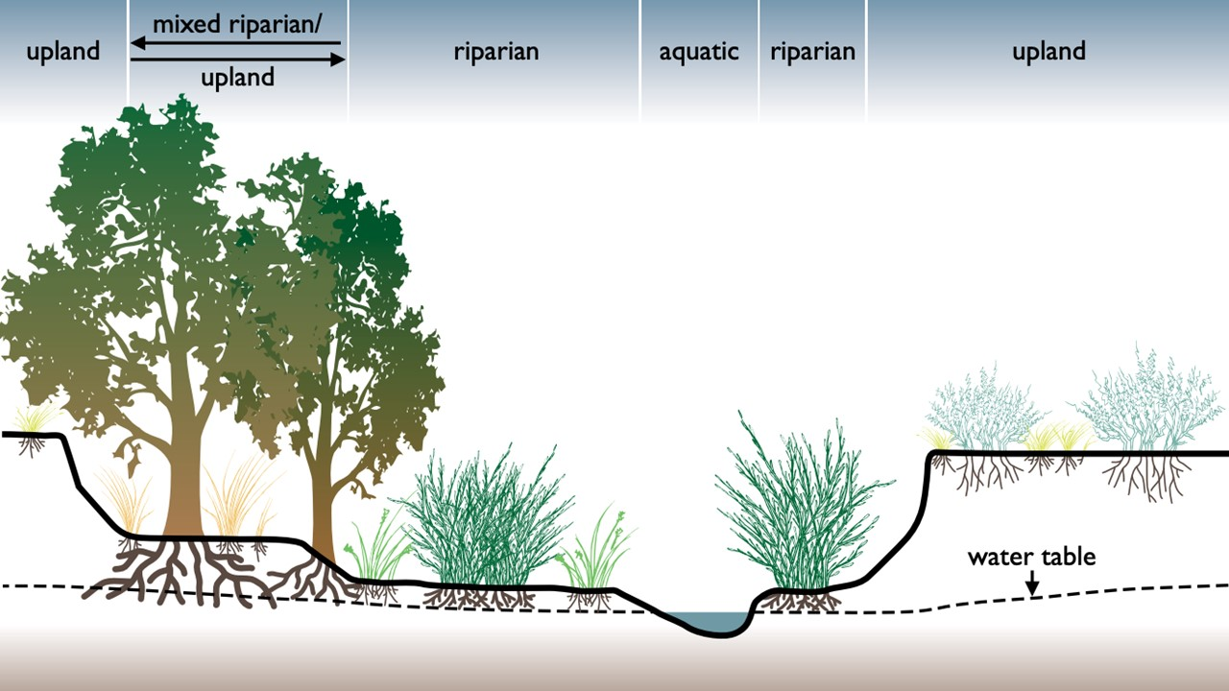
Notes:
Learning your property’s ecotype
Soil Moisture Levels
Diagram of different plant communities based on distance to streambed and water table

Slide 37
Notes:
Learning your property’s ecotype
Soil Types

Slide 38
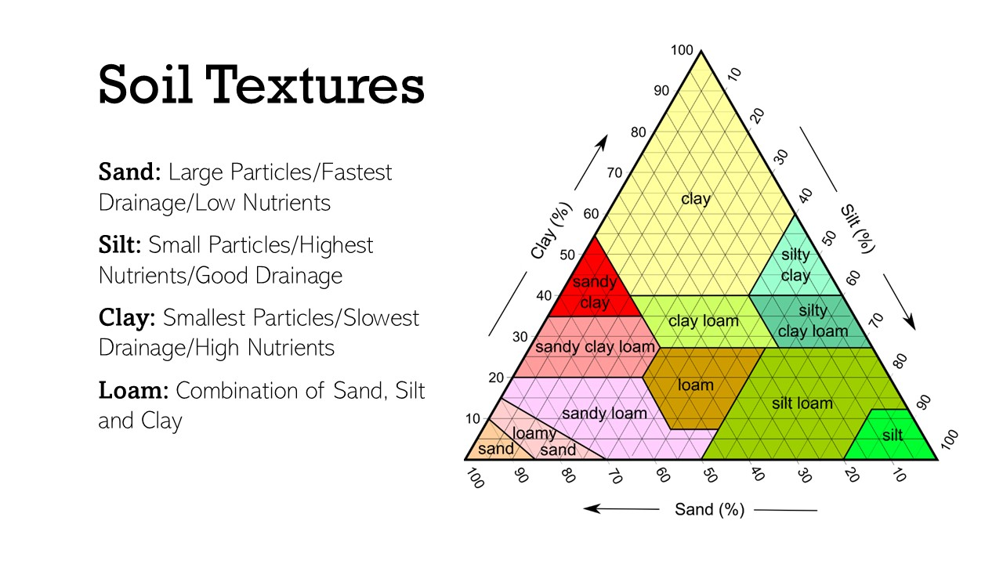
Notes:
Learning your property’s ecotype
Soil Types
Soil Textures Pyramid
Sand: Large Particles/Fastest Drainage/Low Nutrients
Silt: Small Particles/Highest Nutrients/Good Drainage
Clay: Smallest Particles/Slowest Drainage/High Nutrients
Loam: Combination of Sand, Silt and Clay
Knowing exact percentages is not crucial but it’s good to have a general idea

Slide 39
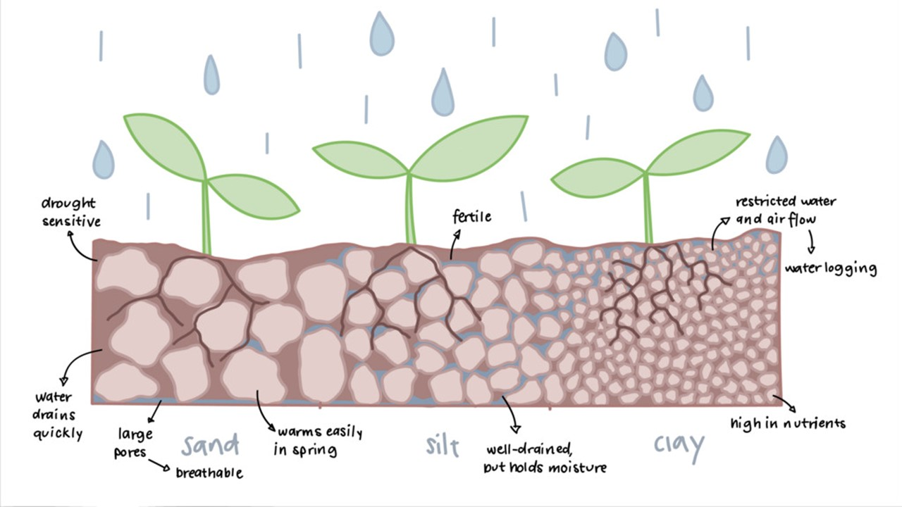
Notes:
Learning your property’s ecotype
Soil Types
Soil Textures
Drawing showing particle size differences in various soils

Slide 40
Notes:
Learning your property’s ecotype
Soil Types
Soil Horizons
Typical depth of soil layers

Slide 41
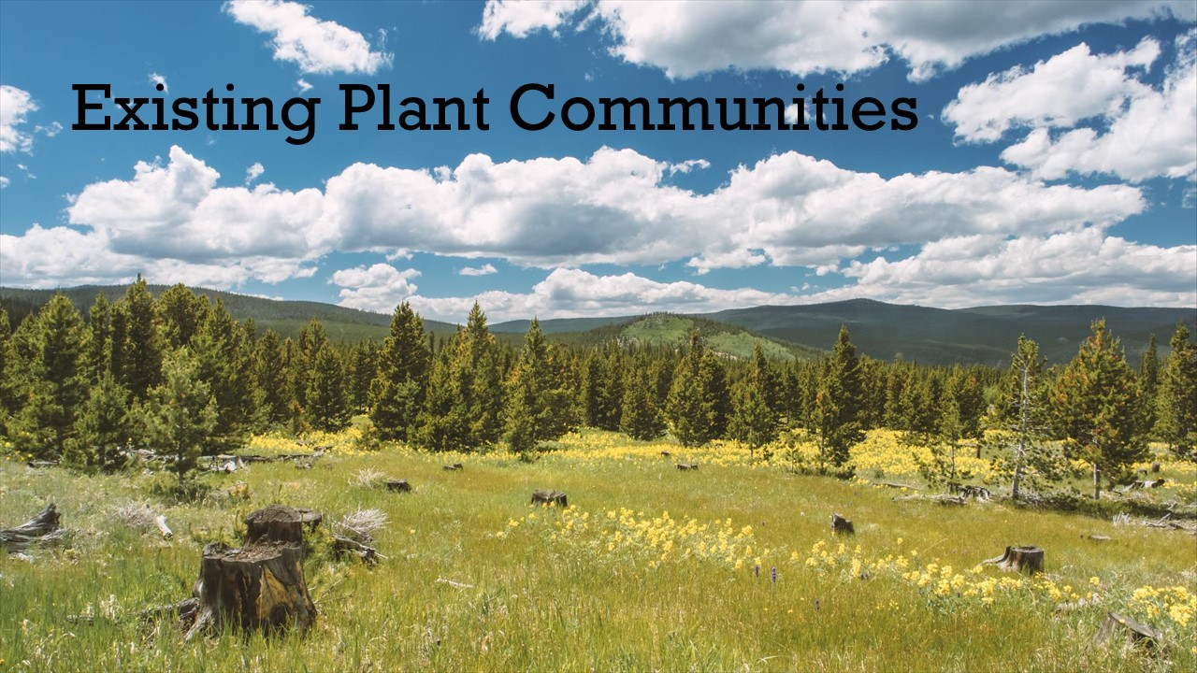
Notes:
Learning your property’s ecotype
Existing Plant Communities
Visit local open spaces to observe native plants in your area

Slide 42
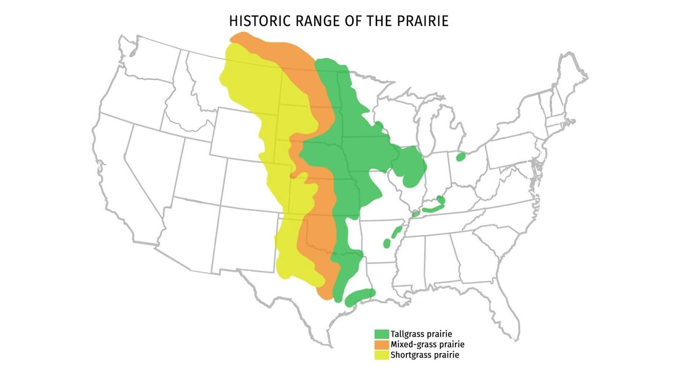
Notes:
Learning your property’s ecotype
Existing Plant Communities
Historic Range of the Prairie
Shows divisions between different prairie types
Different climate as you move East leads to taller grasses and different plant communities

Slide 43
Notes:
Learning your property’s ecotype
Existing Plant Communities
Plant Communities of Colorado Map
Pueblo is listed as Shortgrass Prairie
Other nearby Plant communities include Sandsage Prairie, Sagebrush and Pinyon-Juniper

Slide 44
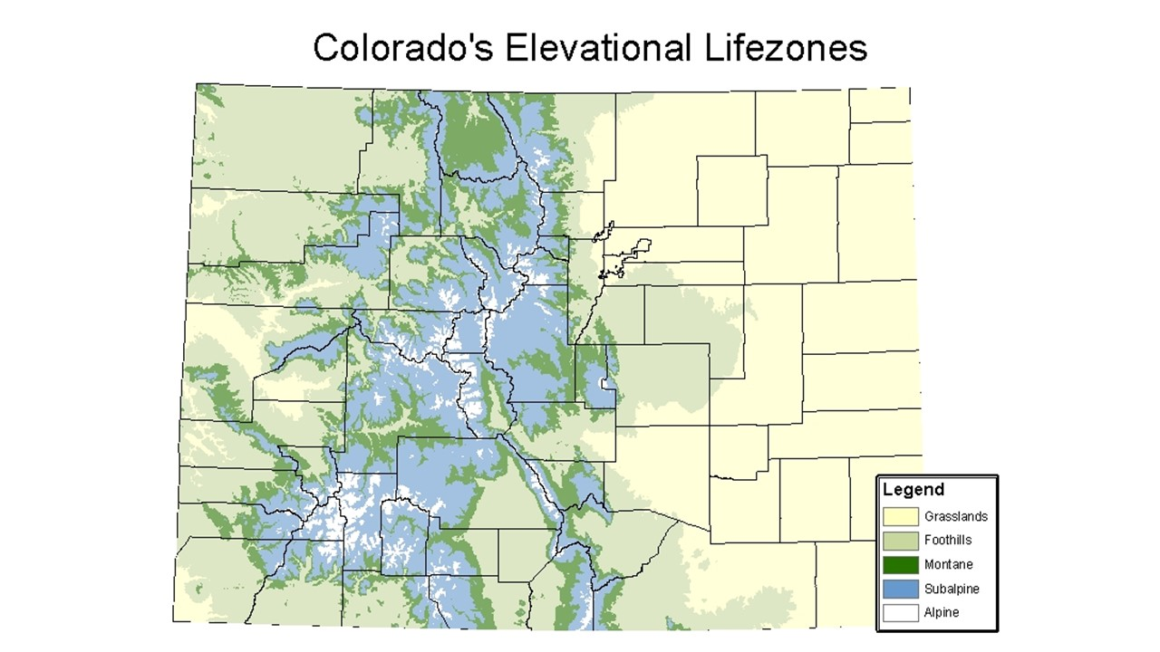
Notes:
Learning your property’s ecotype
Existing Plant Communities
Colorado’s Elevational Lifezones
Elevation influences plant communities due to climate and soil changes

Slide 45
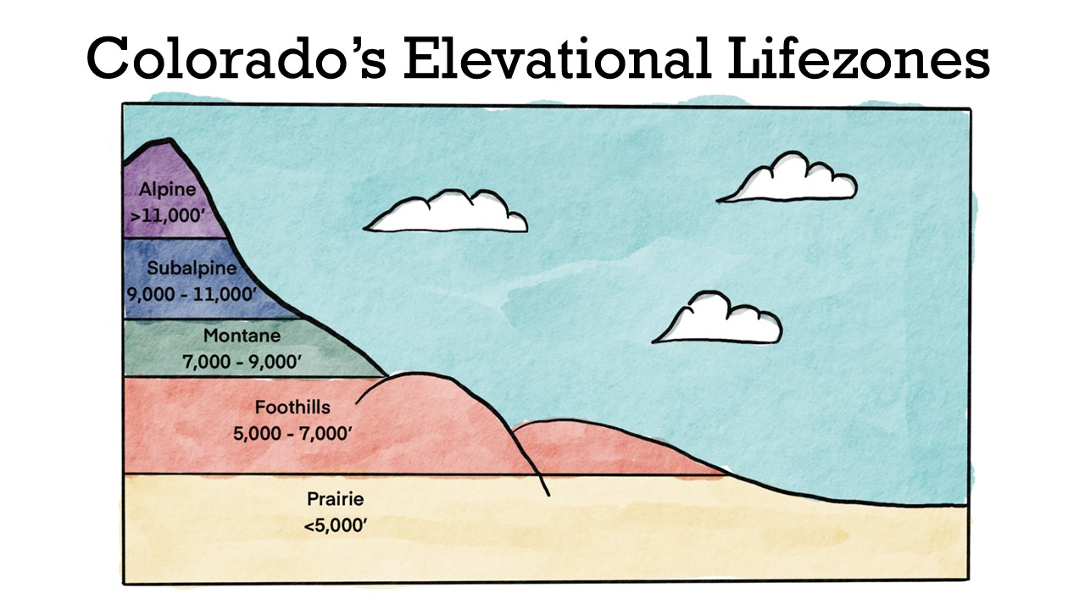
Notes:
Learning your property’s ecotype
Existing Plant Communities
Colorado’s Elevational Lifezones Diagram showing elevation ranges
Elevation influences plant communities

Slide 46
Notes:
Learning your property’s ecotype
Existing Plant Communities
Ecoregions of North America (EPA)
North America has been divided into:
15 broad, level I ecological regions;
50 level II ecological regions intended to provide a more detailed description of the large ecological areas nested within the level I regions; and
182 Level III ecoregions, which are smaller ecological areas nested within level II regions.

Slide 47
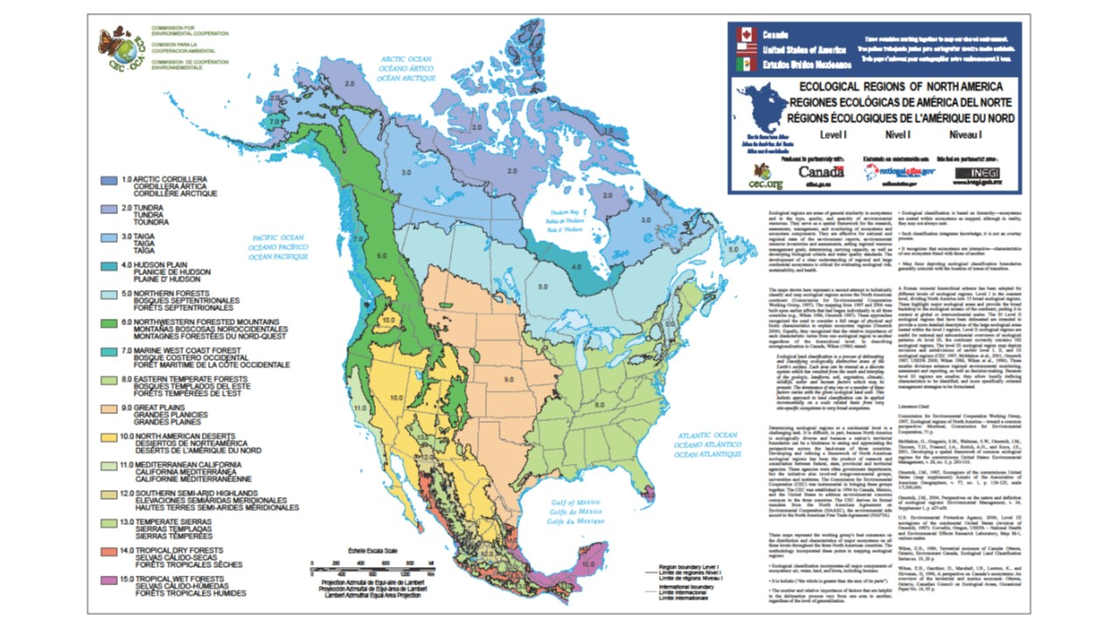
Notes:
Learning your property’s ecotype
Existing Plant Communities
Level 1 Ecoregions
Pueblo is listed as 9.0 – Great Plains

Slide 48
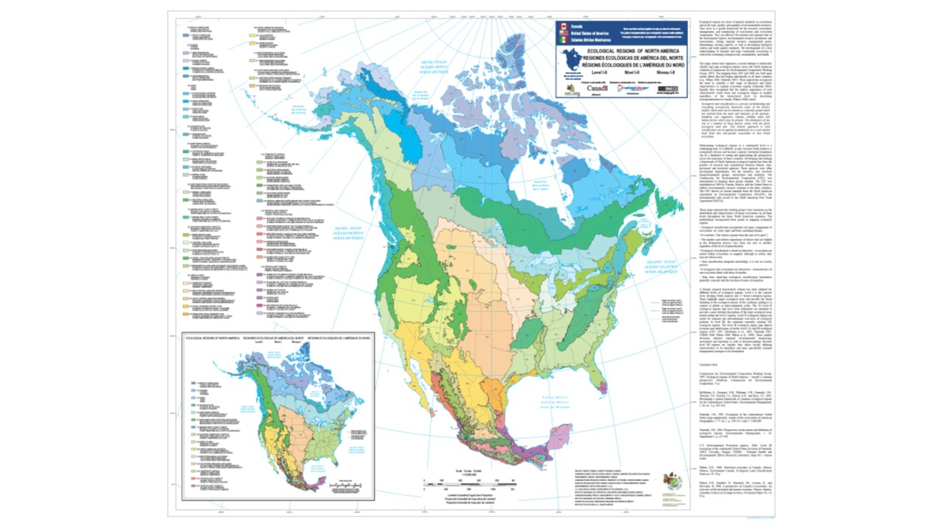
Notes:
Learning your property’s ecotype
Existing Plant Communities
Level 2 Ecoregions
Pueblo is listed as 9.4 – South-Central Semi-Arid Prairie

Slide 49
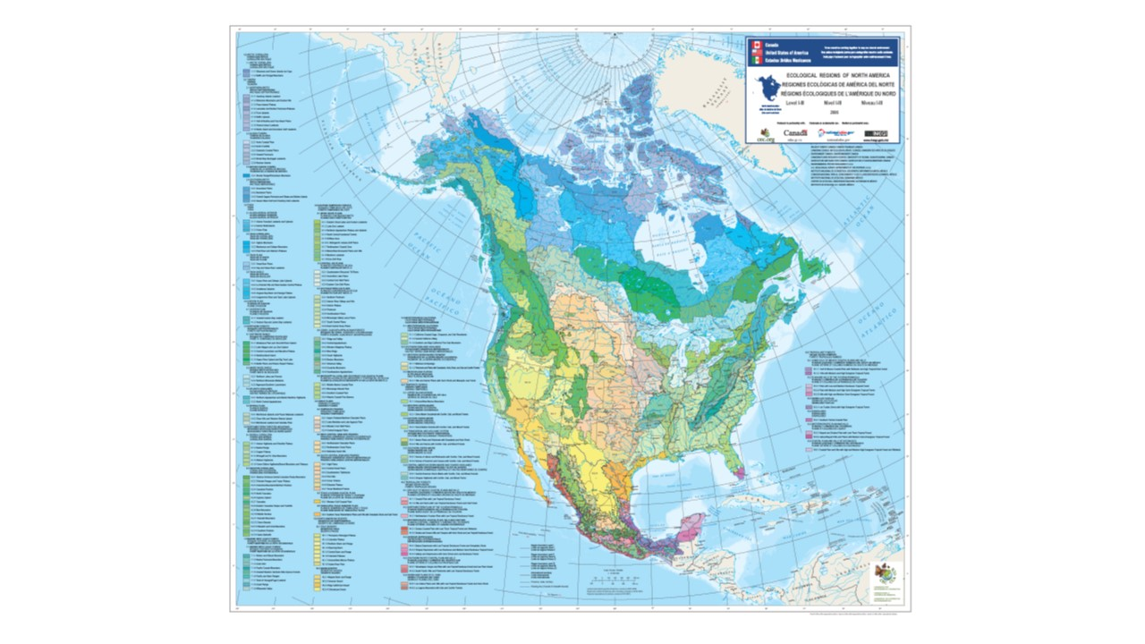
Notes:
Learning your property’s ecotype
Existing Plant Communities
Level 3 Ecoregions
Pueblo is listed as 9.4.3 – Southwestern Tablelands

Slide 50
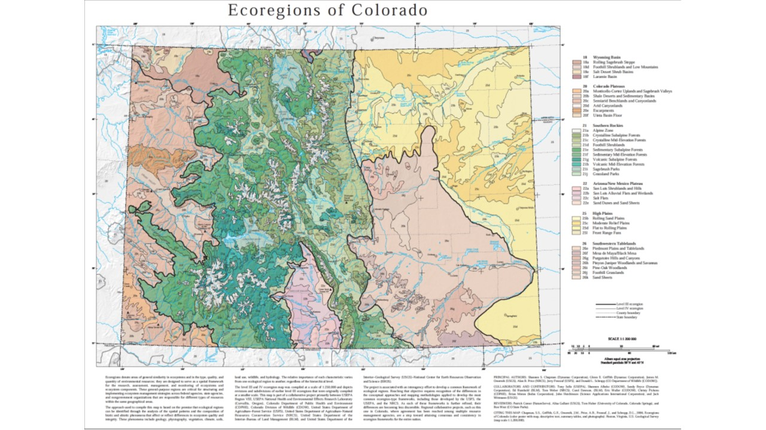
Notes:
Learning your property’s ecotype
Existing Plant Communities
Level 4 Ecoregions
Pueblo is listed as 26e – Piedmont Plains and Tablelands

Slide 51
Notes:
Learning your property’s ecotype
Existing Plant Communities
Part 1 of 4
Where are we?
Level I: Great Plains

Slide 52
Notes:
Learning your property’s ecotype
Existing Plant Communities
Part 2 of 4
Where are we?
Level II: South Central Semi-Arid Prairies

Slide 53
Notes:
Learning your property’s ecotype
Existing Plant Communities
Part 3 of 4
Where are we?
Level III: Southwestern Tablelands

Slide 54
Notes:
Learning your property’s ecotype
Existing Plant Communities
Part 4 of 4
Where are we?
Level IV: Piedmont Plains and Tablelands
The Piedmont Plains and Tablelands ecoregion is a vast area of irregular and dissected plains underlain by shale and sandstone. Precipitation varies from 10 to 16 inches, with the lowest amounts found along the Arkansas River between Pueblo and Las Animas. The shortgrass prairie contains buffalograss, blue grama, western wheatgrass, galleta, alkali sacaton, sand dropseed, sideoats grama, and yucca. Land use is mostly rangeland. Irrigated agriculture occurs along the Arkansas River, and dryland farming is found primarily in the north half of the region.

Slide 55
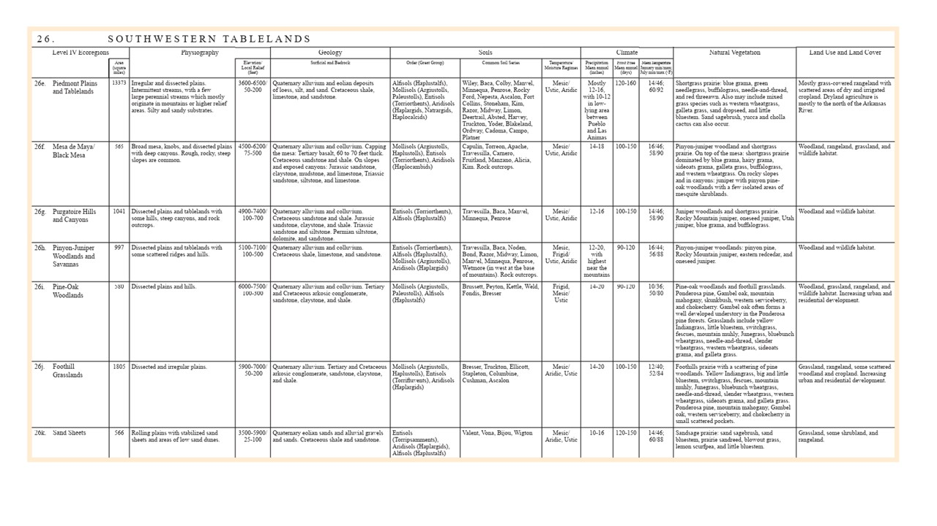
Notes:
Learning your property’s ecotype
Existing Plant Communities
Level 3 Ecoregions – Southwestern Tablelands Chart showing descriptions of all Level 4 subregions
You'll see level to gently rolling tablelands cut by shallow drainages and escarpments—a contrast to the flatter, more uniform areas of shortgrass prairie to the East.
The soils are often derived from shale and sandstone, with more clay content than the sandy soils east of here.
10-12 Inches of precipitation annually

Slide 56
Notes:
Landscape Planning
Now that we understand our regions Climate, Soils and Existing Plant Communities we can work on the details
Using Ecoregion Specific Plant Lists
Landscape Diagrams
Planning Irrigation Using Water Zones
“Right Plant, Right Place”
Select a mix of plants with different bloom periods to keep the garden visually interesting. The more plant diversity the better.
Different definitions of “native” plants:
Continental Natives (May not be native to your specific region but from our continent)
State Natives (Native to your state BUT plants don’t follow geopolitical boundaries so it might be for a different ecotype)
Regional Natives (Natives to your local area)

Slide 57
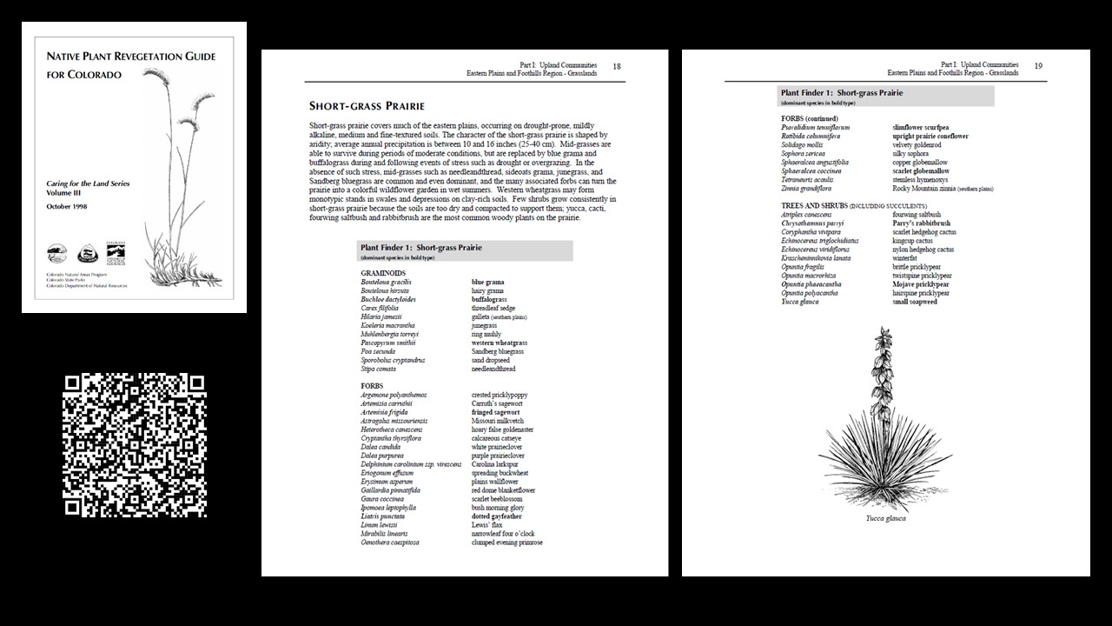
Notes:
Landscape Planning
Using Ecoregion Specific Plant Lists
Native Plant Revegetation Guide for Colorado
Basic Shortgrass Prairie Plant List for Revegetation Projects
Great free resource created by the Colorado Natural Areas Program, Colorado State Parks and the Colorado Department of Natural Resources

Slide 58
Notes:
Landscape Planning
Using Ecoregion Specific Plant Lists
Plant lists provided by conservation organizations
Great lists provided by the National Wildlife Federation, Colorado Native Plant Society and the Xerces Society for Invertebrate Conservation
Often lists bloom time, water/sun/soil requirements and sometimes insect associations

Slide 59
Notes:
Landscape Planning
Using Ecoregion Specific Plant Lists
iNaturalist
Search by Place (Sorted by most observations) Pueblo County
Shows photos taken by users which is helpful

Slide 60
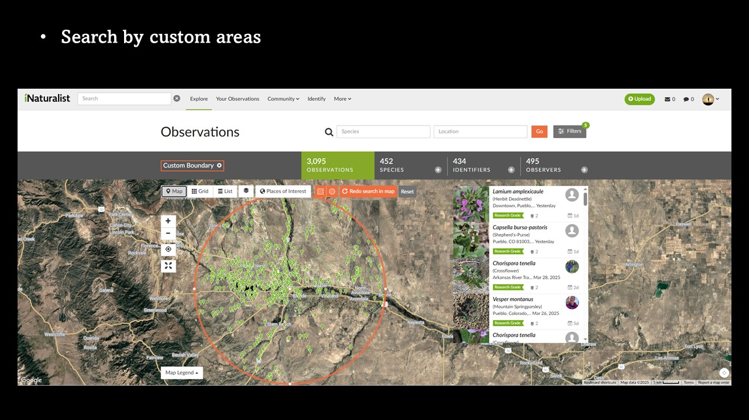
Notes:
Landscape Planning
Using Ecoregion Specific Plant Lists
iNaturalist
Search areas by shape for higher accuracy
Helpful due to microclimates
iNaturalist is also helpful for identifying plants you are not familiar with by submitting photos

Slide 61
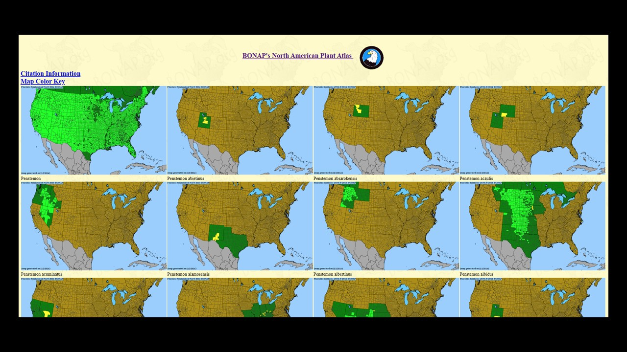
Notes:
Landscape Planning
Using Ecoregion Specific Plant Lists
BONAP (Biota of North America Program)
Native Range maps by genus and species (Penstemon used as example)
Useful for finding native species when you know the genus

Slide 62
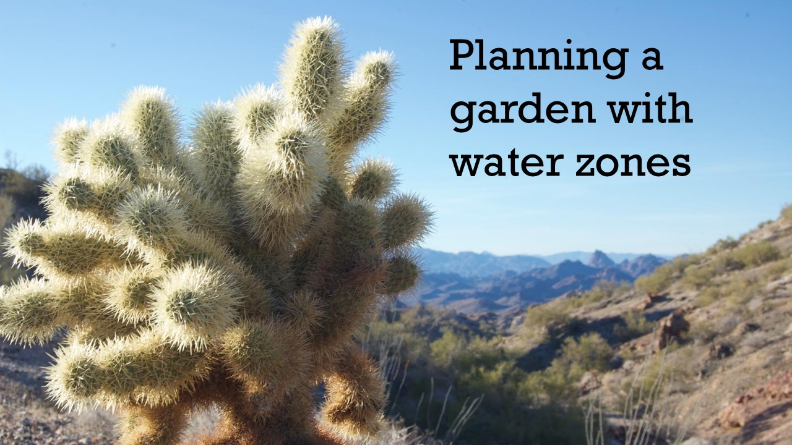
Notes:
Landscape Planning
Planning a garden with water zones
Now that we have plant lists that are applicable to us we will need to start working on plant placement. Plants have different water and sun requirements so we will want to place them with other plants with similar needs.

Slide 63
Notes:
Landscape Planning
Planning a garden with water zones
A common gardening mistake is not placing plants with other plants that have similar water needs. Placing a plant with high water needs amongst plants with low water needs leads to more work and unhealthy plants.
High Water
Mesic Zone
Moderate Water
Transition Zone
Low Water
Xeric Zone
Very Low Water
Very Xeric Zone
No Water
Can survive on natural precipitation alone

Slide 64
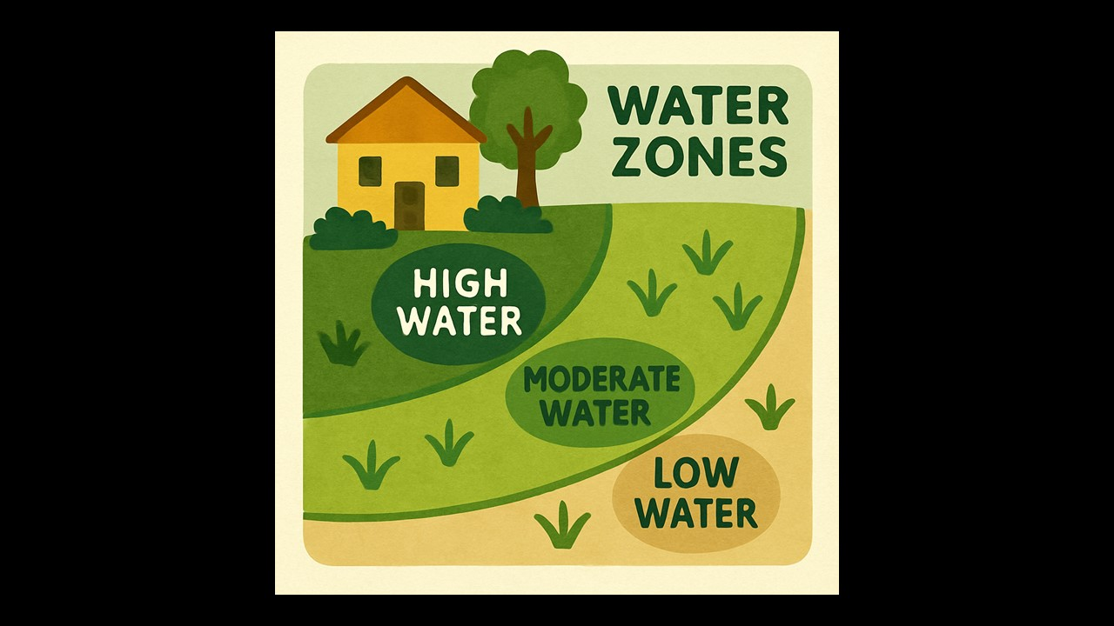
Notes:
Landscape Planning
Planning a garden with water zones
Place High Water Zones closest to the house and Low Water furthest out
If using an irrigation timer these should be different zones with different times

Slide 65
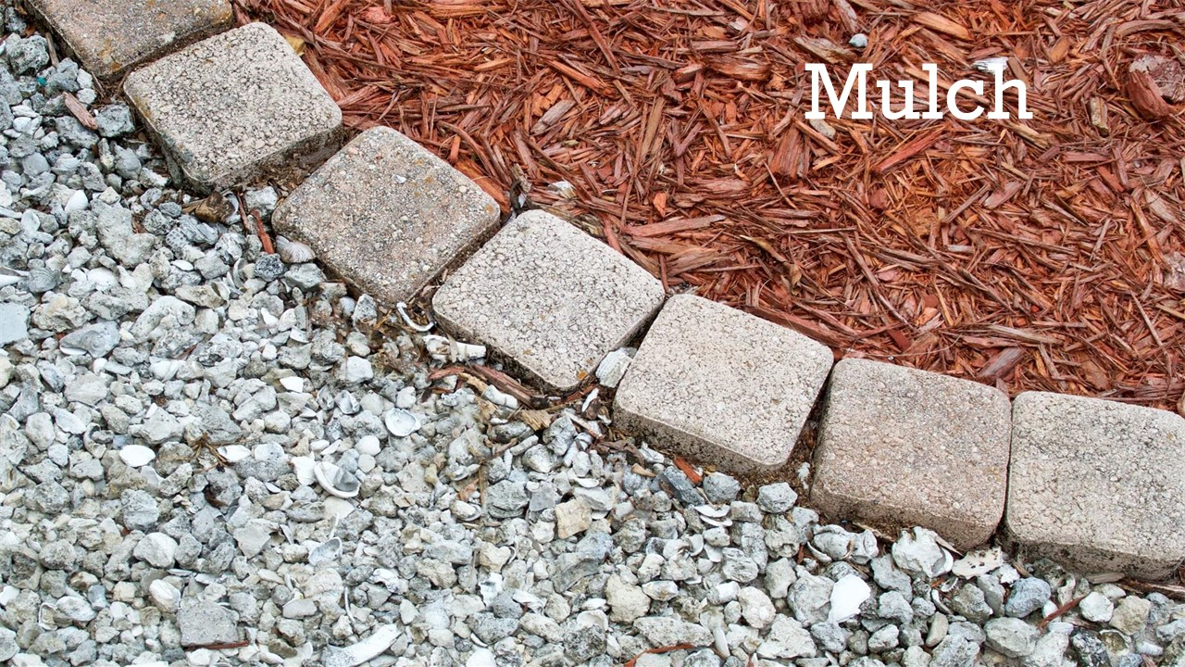
Notes:
Landscape Planning
Mulch
Purposes of mulch: retaining moisture, weed suppression, erosion control.
Rock mulch is a better choice for our native plants.
Prairie plants are not adapted to the presence of woody debris, and wood mulch can disrupt the natural ecosystem
Wood mulch can reduce water infiltration and decomposition can steal nitrogen temporarily
Works best in mesic (more water) areas with woodland plants

Slide 66
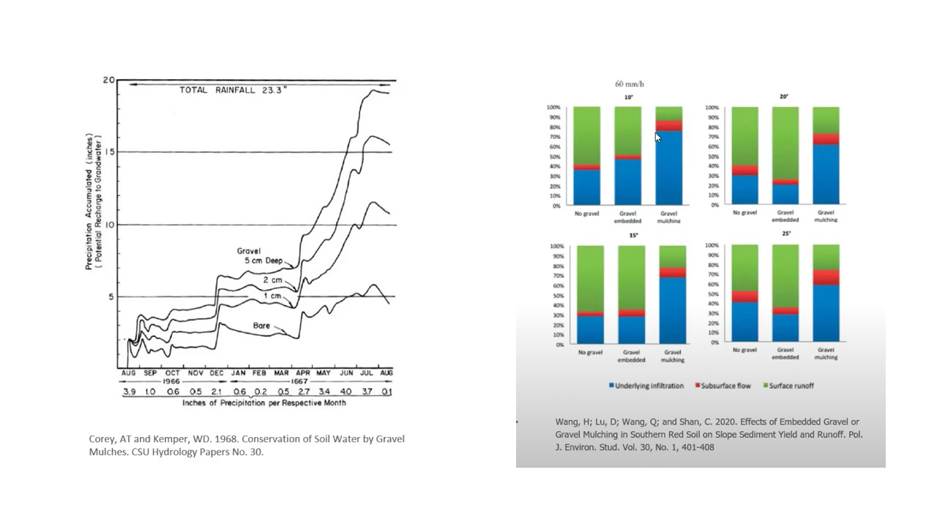
Notes:
Landscape Planning
Mulch
Rock Mulch
Charts and Graphs from research studies showing how gravel mulches retain more water in the soil

Slide 67
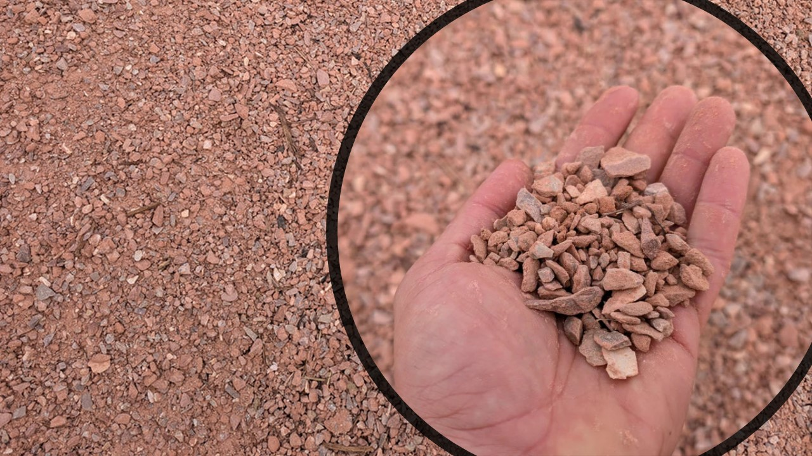
Notes:
Landscape Planning
Mulch
Breeze
Breeze, also known as crusher fines is a finely crushed gravel, ideal for native plants because it doesn't absorb water like organic mulches. Instead, it allows rainwater to pass through easily to the soil below, helping plants get the moisture they need. It also reduces evaporation, suppresses weeds, and insulates the soil against temperature extremes. Durable and low-maintenance, breeze provides a clean, natural appearance that fits well with drought-tolerant landscapes.
Better Soil Contact: Breeze compacts slightly and settles into a stable layer, making better contact with the soil and reducing air gaps that can lead to weed growth. Pea gravel tends to roll around and shift, making it less effective at weed suppression and moisture retention.
Stays in Place: Breeze’s fine texture helps it lock together, so it’s less likely to wash or blow away. Pea gravel is round and loose, so it moves more easily in wind or heavy rain.
Improved Water Infiltration: While both are permeable, breeze creates a thin crust that still allows water through while slowing evaporation. Pea gravel can allow water to run between the stones without moistening the top layer of soil effectively.

Slide 68
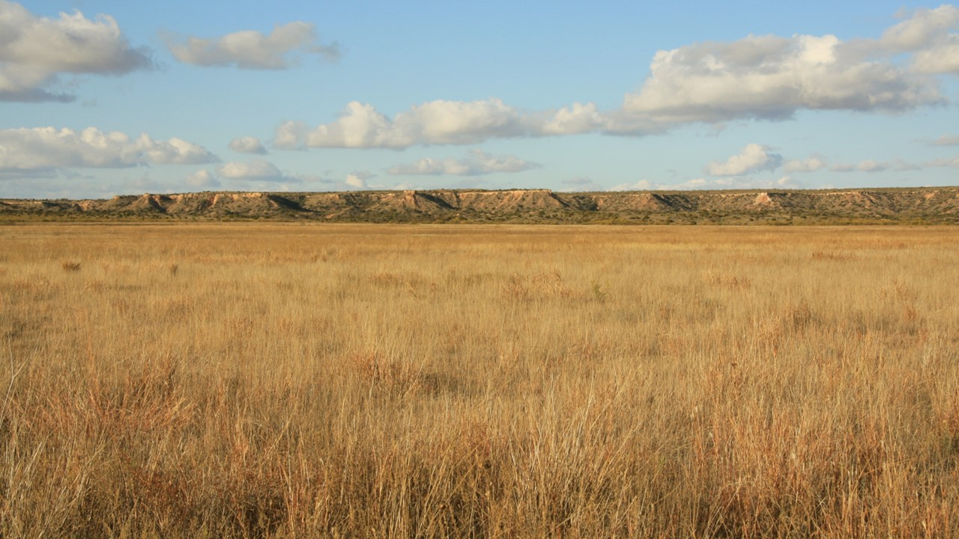
Notes:
Landscape Planning
Mulch
Green Mulch – By planting densely you can create a living mulch that provides all the benefits of traditional mulch

Slide 69
Notes:
Landscape Planning
Landscape Diagrams
Very useful especially when working with nursery transplants
Helps visualize a plan

Slide 70
Notes:
Landscape Planning
Landscape Diagrams
Free Example by Lauren Springer Ogden for Plant Select

Slide 71
Notes:
Landscape Planning
Landscape Diagrams
Matrix Planning
Primary Plants – Visually dominant plants (Desert Princes Plume, Penstemon, etc)
Matrix Plants – Foundational structure plants/groundcover (Native Grasses)
Scatter Plants – Enhance the naturalistic look of a design (Rabbitbrush, Saltbush, Yucca, etc)

Slide 72
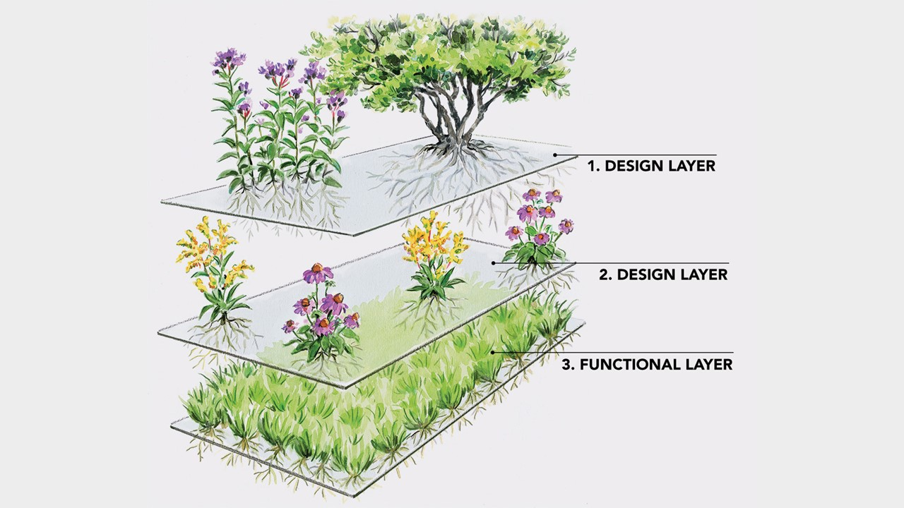
Notes:
Landscape Planning
Drawing a Landscape Diagram
Layered Planning
Design Layer – Structural Plants
Design Layer – Seasonal interest plants
Functional Layer – Living mulch

Slide 73
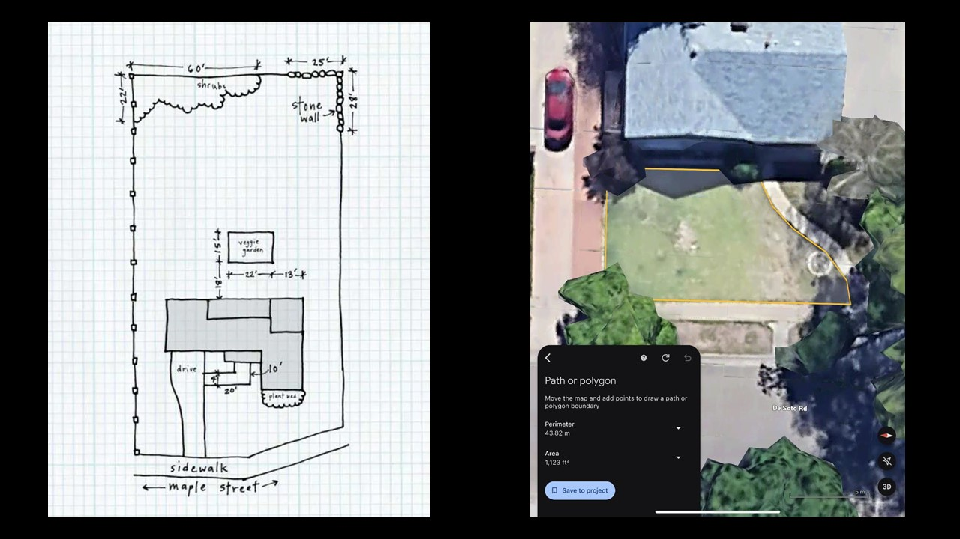
Notes:
Landscape Planning
Drawing a Landscape Diagram
Using graph paper to draw to scale
In this example each square is 5 square feet
Using Google Earth to measure garden perimeters for square footage

Slide 74
Notes:
Landscape Planning
Native Garden Expectations
Wilder look compared to traditional gardens (Gardening for the ecosystem vs Gardening for aesthetics alone)
Embrace the ever-changing chaos
Plants will die and other plants will take their place
Annuals reseed and spread to new locations
Rhizomatous plants create colonies
Timeframes (it takes years)

Slide 75
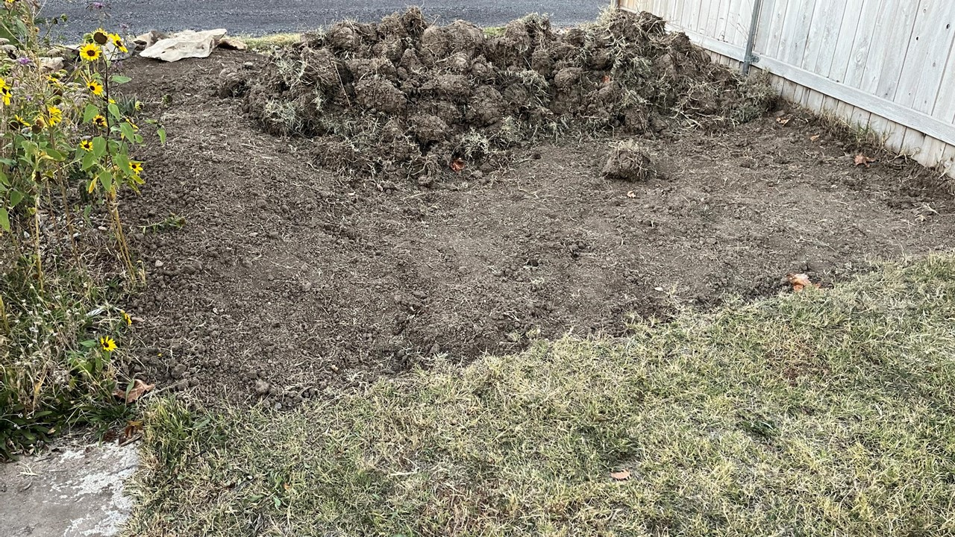
Notes:
Landscape Planning
Native Garden Expectations
Turf Removal

Slide 76
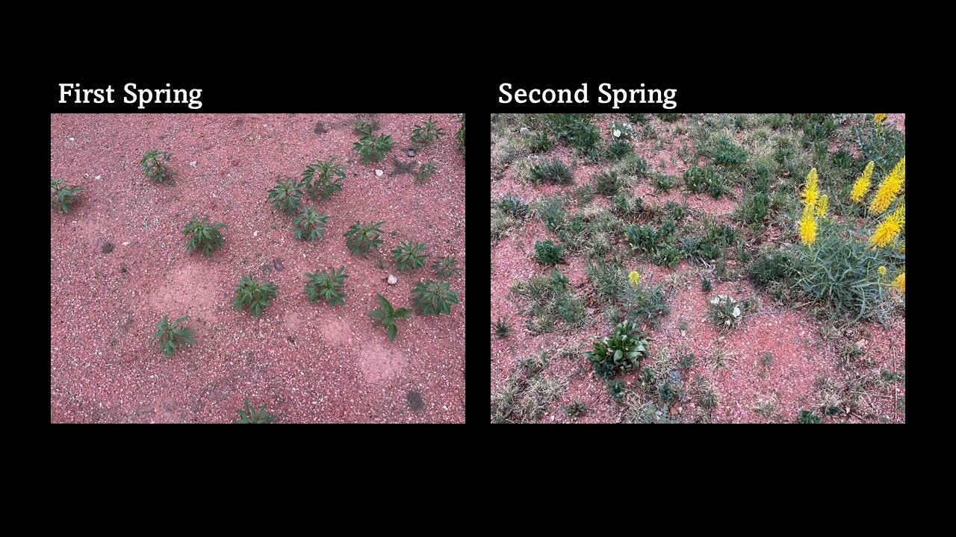
Notes:
Landscape Planning
Native Garden Expectations
First Spring after seeding vs Second Spring
First year is always slow as new plants establish themselves. Use annuals to provide cover and prevent erosion
2nd year the matrix plants (native grasses) have filled in and perennials will mature and likely bloom

Slide 77
Notes:
Landscape Planning
Native Garden Expectations
First Spring after seeding vs Second Spring
Late Spring, showing fill in

Slide 78
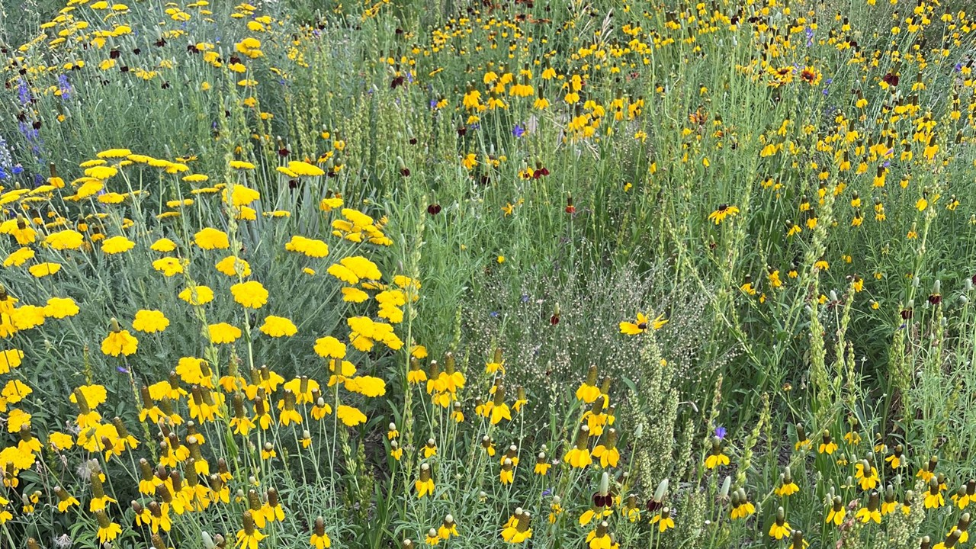
Notes:
Landscape Planning
Native Garden Expectations
Established Garden after 2-3 Years

Slide 79
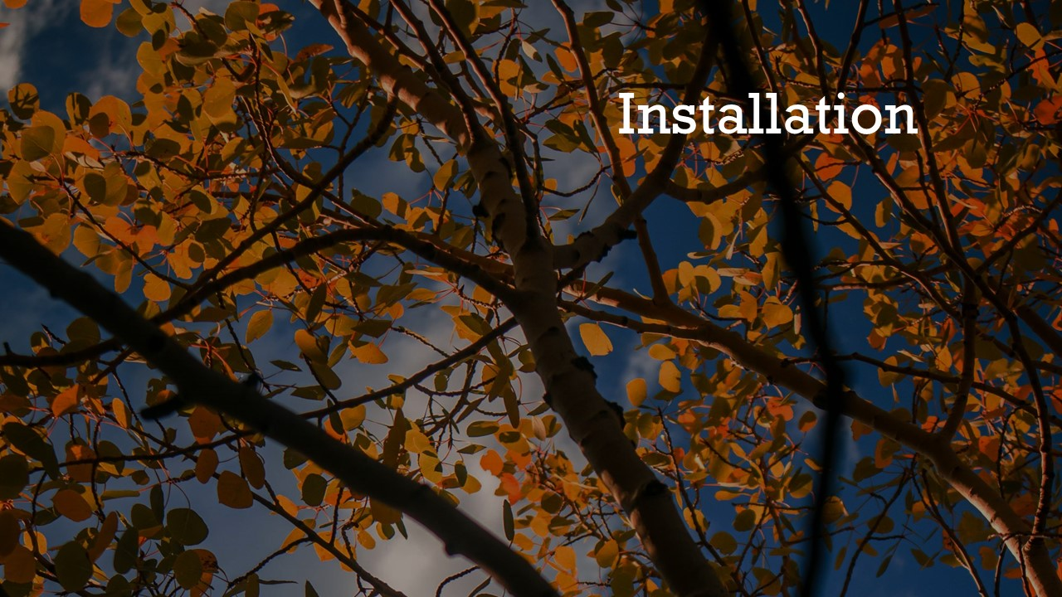
Notes:
Installation

Slide 80
Notes:
Installation
Site Preparation
Soil Testing
Fixing compacted soil
Don’t dig too deep to keep topsoil intact
Turf Removal
Herbicides
Sheet mulching
Mechanical removal

Slide 81
Notes:
Installation
Seeding
Spread in Fall for Cold Stratification
Mix 6:1 Sand and Seed
Broadcast Seed
Press Seed into Soil
Simulate “Wet Spring” Conditions
Seed over Several Years

Slide 82
Notes:
Installation
Transplanting
“Right Plant, Right Place”
Transplant in Spring or Fall
Use Correct Planting Techniques
Water Regularly during Establishment

Slide 83
Notes:
Maintenance

Slide 84
Notes:
Maintenance
Irrigation
Do you need to water?
How much water does your garden need?
Which watering methods are best?
Hand-watering
Drip Irrigation
Sprinklers

Slide 85
Notes:
Maintenance
Garden Clean-up
Why wait until Spring?
Winter seed for birds
Shelter for overwintering insects
“Leave the Leaves?”
Great for woodlands but not natural for prairies without trees
Consider places in your garden where you can spread leaves (under trees, compost bin/leaf mold pile)

Slide 86
Notes:
Legalities
HOA Restrictions
(Part 1 of 2)
SB23-178 “Water-wise Landscaping In Homeowners' Association Communities”

Slide 87
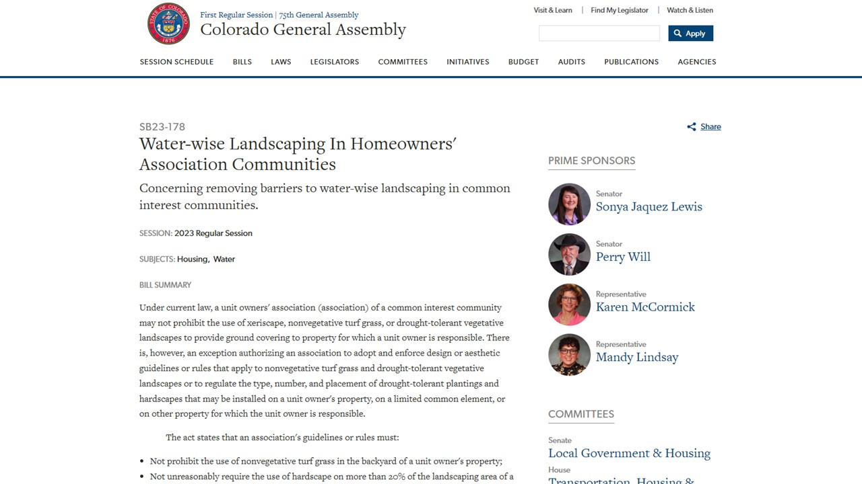
Notes:
Legalities
HOA Restrictions
SB23-178 “Water-wise Landscaping In Homeowners' Association Communities”
(Part 2 of 2)
The act states that an association's guidelines or rules must:
Not prohibit the use of nonvegetative turf grass in the backyard of a unit owner's property;
Not unreasonably require the use of hardscape on more than 20% of the landscaping area of a unit owner's property;
Allow a unit owner an option that consists of at least 80% drought-tolerant plantings; and
Not prohibit vegetable gardens in the front, back, or side yard of a unit owner's property.

Slide 88
Notes:
Legalities
City Codes against “Weeds”
(Part 1 of 2)
City of Pueblo TITLE VII Chapter 4 – WEEDS
Advocating for Code Enforcement changes

Slide 89
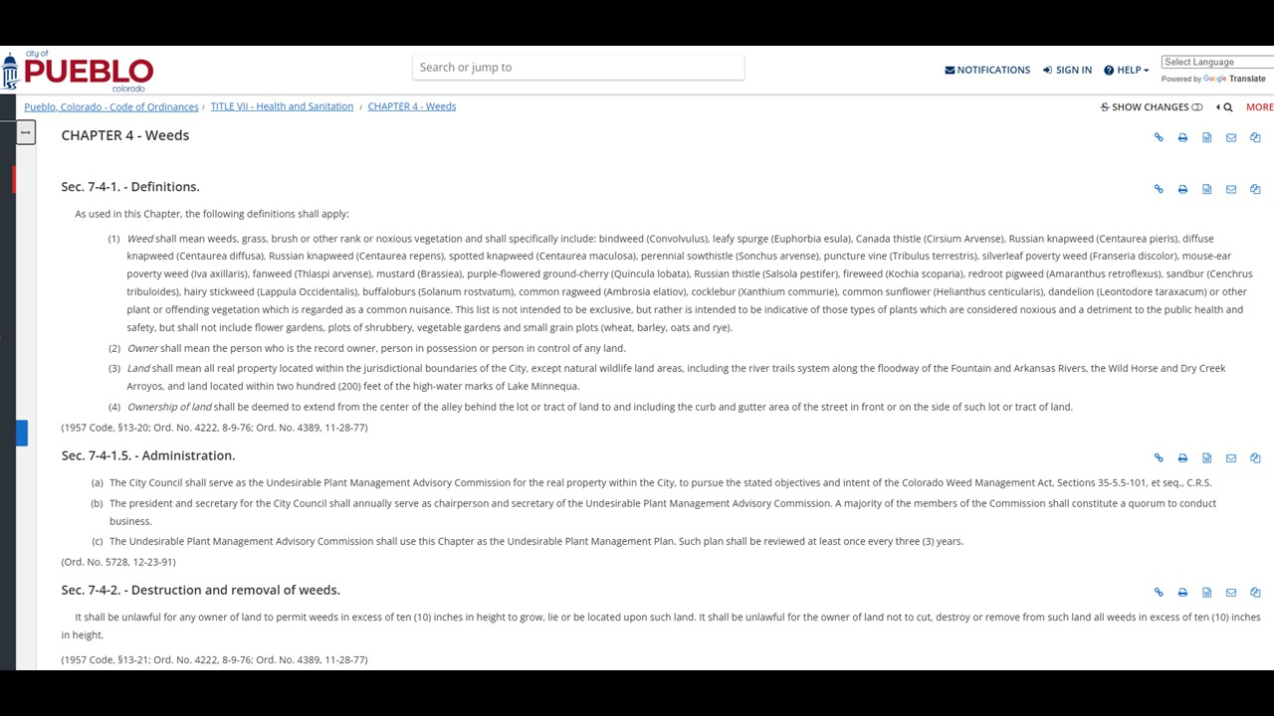
Notes:
Legalities
City Codes against “Weeds”
(Part 2 of 2)
City of Pueblo TITLE VII Chapter 4 – WEEDS
8 of 24 listed “Weeds” are natives
Natives on “Weed List:
Ambrosia artemisiifolia (Common Ragweed)
Ambrosia tomentosa Skeletonleaf Bur Ragweed)
Iva axillaris (Poverty Weed)
Lappula Occidentalis (Flatspine Stickseed)
Helianthus annuus Common Sunflower
Quincula lobata (Purple Groundcherry)
Solanum rostratum (Buffalo-Bur)
ALL of Brassiceae considered a weed (Mustard Family)
It shall be unlawful for any owner of land to permit weeds in excess of ten (10) inches in height to grow, lie or be located upon such land.
The city and code enforcement do not identify plants and if someone complains and your plants are over 10 inches tall then they could be at risk of being removed.

Slide 90
Notes:
Selected Native Plants for Southeast Colorado
Selected based off of availability of seeds/transplants
It is difficult to find many native species commercially

Slide 91
Notes:
Selected Native Plants for Southeast Colorado
Selected Native Grasses
Not all grasses are listed
Bouteloua dactyloides (Buffalograss)
Bouteloua gracilis (Blue Grama)
Bouteloua curtipendula (Sideoats Grama)
Aristada purpurea (Purple Three-Awn)
Hilaria jamesii (James’ Galleta Grass)
Koeleria macrantha (Prairie Junegrass)
Heterostipa comata (Needle and Thread Grass)
Sporobolus cryptandrus (Sand Dropseed)

Slide 92
Notes:
Selected Native Plants for Southeast Colorado
Machaeranthera tanacetifolia
Tahoka Daisy
Family: Asteraceae (Sunflower)
Type: Annual
Bloom Period: Late Spring - Summer
Height: 1 foot
Width: 1 foot

Slide 93
Notes:
Selected Native Plants for Southeast Colorado
Cleomella serrulata
Rocky Mountain Bee Plant
Family: Cleomaceae (Spider Flower)
Type: Annual
Bloom Period: Late Spring - Summer
Height: 2-6 feet
Width: 1-2 feet

Slide 94
Notes:
Selected Native Plants for Southeast Colorado
Polanisia dodecandra
Redwhisker Clammyweed
Family: Cleomaceae (Spider Flower)
Type: Annual
Bloom Period: Late Spring - Summer
Height: 1-2 feet
Width: 1-2 feet

Slide 95
Notes:
Selected Native Plants for Southeast Colorado
Coreopsis tinctoria
Plains Coreopsis
Family: Asteraceae (Sunflower)
Type: Annual
Bloom Period: Late Spring - Summer
Height: 1-2 feet
Width: 1-2 feet

Slide 96
Notes:
Selected Native Plants for Southeast Colorado
Sphaeralcea coccinea
Scarlet Globemallow
Family: Malvaceae (Mallow)
Type: Perennial
Bloom Period: Late Spring - Summer
Height: 1 foot
Width: 1 foot

Slide 97
Notes:
Selected Native Plants for Southeast Colorado
Zinnia grandiflora
Rocky Mountain Zinnia
Family: Asteraceae (Sunflower)
Type: Perennial
Bloom Period: Summer - Fall
Height: 4-8 inches
Width: 4-8 inches

Slide 98
Notes:
Selected Native Plants for Southeast Colorado
Heterotheca hirsutissima
Harsh False Goldenaster
Family: Asteraceae (Sunflower)
Type: Perennial
Bloom Period: Summer - Fall
Height: 6-12 inches
Width: 1-2 feet

Slide 99
Notes:
Selected Native Plants for Southeast Colorado
Melampodium leucanthum
Blackfoot Daisy
Family: Asteraceae (Sunflower)
Type: Perennial
Bloom Period: Summer
Height: 6-12 inches
Width: 1-2 feet

Slide 100
Notes:
Selected Native Plants for Southeast Colorado
Oenothera cespitosa
Fragrant Evening Primrose
Family: Onagraceae (Evening Primrose)
Type: Perennial
Bloom Period: Spring - Summer
Height: 6-8 inches
Width: 8-10 inches

Slide 101
Notes:
Selected Native Plants for Southeast Colorado
Oenothera lavandulifolia
Lavenderleaf Sundrops
Family: Onagraceae (Evening Primrose)
Type: Perennial
Bloom Period: Spring - Summer
Height: 6-8 inches
Width: 8-10 inches

Slide 102
Notes:
Selected Native Plants for Southeast Colorado
Liatris punctata
Dotted Gayfeather
Family: Asteraceae (Sunflower)
Type: Perennial
Bloom Period: Late Summer
Height: 1-2 feet
Width: 1-2 feet

Slide 103
Notes:
Selected Native Plants for Southeast Colorado
Gaillardia pinnatifida
Red Dome Blanketflower
Family: Asteraceae (Sunflower)
Type: Perennial
Bloom Period: Spring - Summer
Height: 1-2 feet
Width: 1 foot

Slide 104
Notes:
Selected Native Plants for Southeast Colorado
Physaria fendleri
Fendler’s Bladderpod
Family: Brassicaceae (Mustard)
Type: Perennial
Bloom Period: Spring
Height: 2-10 inches
Width: 6-12 inches

Slide 105
Notes:
Selected Native Plants for Southeast Colorado
Mirabilis multiflora
Colorado Four o’Clock
Family: Nyctaginaceae (Four o’Clock)
Type: Perennial
Bloom Period: Spring - Summer
Height: 1-2 feet
Width: 3-5 feet

Slide 106
Notes:
Selected Native Plants for Southeast Colorado
Artemisia frigida
Fringed Sagebrush
Family: Asteraceae (Sunflower)
Type: Perennial
Bloom Period: Spring - Summer
Height: 1-2 feet
Width: 1-2 feet

Slide 107
Notes:
Selected Native Plants for Southeast Colorado
Eriogonum effusum
Spreading Buckwheat
Family: Polygonaceae (Buckwheat)
Type: Perennial
Bloom Period: Spring - Summer
Height: 1-2 feet
Width: 2-5 feet

Slide 108
Notes:
Selected Native Plants for Southeast Colorado
Glandularia wrightii
Davis Mountain Mock Vervain
Family: Verbenaceae (Vervain)
Type: Perennial
Bloom Period: Spring - Summer
Height: 1 foot
Width: 1-3 feet

Slide 109
Notes:
Selected Native Plants for Southeast Colorado
Stanleya pinnata
Desert Prince’s Plume
Family: Brassicaceae (Mustard)
Type: Perennial
Bloom Period: Spring - Summer
Height: 3-6 feet
Width: 2-3 feet

Slide 110
Notes:
Selected Native Plants for Southeast Colorado
Mentzelia decapetala
Ten-Petal Stickleaf
Family: Loasaceae (Stickleaf)
Type: Biennial
Bloom Period: Summer
Height: 2-5 feet
Width: 1-3 feet

Slide 111
Notes:
Selected Native Plants for Southeast Colorado
Asclepias speciosa
Showy Milkweed
Family: Apocynaceae (Dogbane)
Type: Perennial
Bloom Period: Summer
Height: 2-4 feet
Width: 1-2 feet

Slide 112
Notes:
Selected Native Plants for Southeast Colorado
Symphyotrichum ericoides
White Heath Aster
Family: Asteraceae (Sunflower)
Type: Perennial
Bloom Period: Late Summer - Fall
Height: 1-3 feet
Width: 1-2 feet

Slide 113
Notes:
Selected Native Plants for Southeast Colorado
Brickellia grandiflora
Tasselflower Brickellia
Family: Asteraceae (Sunflower)
Type: Perennial
Bloom Period: Late Summer - Fall
Height: 1-3 feet
Width: 1-3 feet

Slide 114
Notes:
Selected Native Plants for Southeast Colorado
Ratibida columnifera
Upright Prairie Coneflower
Family: Asteraceae (Sunflower)
Type: Perennial
Bloom Period: Summer
Height: 1-3 feet
Width: 1-2 feet

Slide 115
Notes:
Selected Native Plants for Southeast Colorado
Penstemon auriberbis
Colorado Beardtongue
Family: Plantaginaceae (Plantain)
Type: Perennial
Bloom Period: Late Spring – Early Summer
Height: 4-12 inches
Width: 2-6 inches

Slide 116
Notes:
Selected Native Plants for Southeast Colorado
Penstemon virens
Front Range Beardtongue
Family: Plantaginaceae (Plantain)
Type: Perennial
Bloom Period: Late Spring – Early Summer
Height: 6-12 inches
Width: 8-10 inches

Slide 117
Notes:
Selected Native Plants for Southeast Colorado
Yucca glauca
Great Plains Yucca
Family: Asparagaceae (Asparagus)
Type: Perennial
Bloom Period: Late Spring – Early Summer
Height: 1-2 feet
Width: 1-2 feet

Slide 118
Notes:
Selected Native Plants for Southeast Colorado
Echinocereus coccineus
Scarlet Hedgehog Cactus
Family: Cactaceae (Cactus)
Type: Perennial
Bloom Period: Late Spring – Early Summer
Height: 1-2 feet
Width: 2-4 feet

Slide 119
Notes:
Selected Native Plants for Southeast Colorado
Cylindropuntia imbricata
Tree Cholla
Family: Cactaceae (Cactus)
Type: Perennial
Bloom Period: Late Spring – Early Summer
Height: 3-8 feet
Width: 3-8 feet

Slide 120
Notes:
Selected Native Plants for Southeast Colorado
Escobaria vivipara
Spinystar Cactus
Family: Cactaceae (Cactus)
Type: Perennial
Bloom Period: Late Spring – Early Summer
Height: 2-6 inches
Width: 4-6 inches

Slide 121
Notes:
Selected Native Plants for Southeast Colorado
Opuntia polyacantha
Plains Pricklypear
Family: Cactaceae (Cactus)
Type: Perennial
Bloom Period: Late Spring – Early Summer
Height: 1-2 feet
Width: 1-4 feet

Slide 122
Notes:
Selected Native Plants for Southeast Colorado
Krascheninnikovia lanata
Winterfat
Family: Chenopodiaceae (Goosefoot)
Type: Perennial
Bloom Period: Fall
Height: 1-3 feet
Width: 1-3 feet

Slide 123
Notes:
Selected Native Plants for Southeast Colorado
Ericameria nauseosa
Rubber Rabbitbrush
Family: Asteraceae (Sunflower)
Type: Perennial
Bloom Period: Fall
Height: 4-7 feet
Width: 4-7 feet

Slide 124
Notes:
Selected Native Plants for Southeast Colorado
Atriplex canescens
Fourwing Saltbush
Family: Amaranthaceae (Amaranth)
Type: Perennial
Bloom Period: Spring - Summer
Height: 3-6 feet
Width: 4-8 feet

Slide 125
Notes:
Selected Native Plants for Southeast Colorado
Rhus trilobata
Threeleaf Sumac
Family: Anacardiaceae (Cashew)
Type: Perennial
Bloom Period: Spring – Early Summer
Height: 3-8 feet
Width: 3-8 feet

Slide 126
Notes:
Selected Native Plants for Southeast Colorado
Cercocarpus montanus
Alderleaf Mountain Mahogany
Family: Rosaceae (Rose)
Type: Perennial
Bloom Period: Spring
Height: 8-20 feet
Width: 4-8 feet

Slide 127
Notes:
Selected Native Plants for Southeast Colorado
Ribes aureum
Golden Currant
Family: Grossulariaceae (Gooseberry)
Type: Perennial
Bloom Period: Spring
Height: 6-8 feet
Width: 6-8 feet

Slide 128
Notes:
Selected Native Plants for Southeast Colorado
Rosa woodsii
Woods’ Rose
Family: Rosaceae (Rose)
Type: Perennial
Bloom Period: Spring
Height: 3-6 feet
Width: 3-6 feet

Slide 129
Notes:
Selected Native Plants for Southeast Colorado
Holodiscus discolor
Ocean Spray
Family: Rosaceae (Rose)
Type: Perennial
Bloom Period: Summer
Height: 3-20 feet
Width: 4-15 feet

Slide 130
Notes:
Selected Native Plants for Southeast Colorado
Quercus gambelii
Gambel Oak
Family: Fagaceae (Beech)
Type: Perennial
Bloom Period: Spring
Height: 10-25 feet
Width: 10-20 feet

Slide 131
Notes:
Selected Native Plants for Southeast Colorado
Prunus americana
American Plum
Family: Rosaceae (Rose)
Type: Perennial
Bloom Period: Spring
Height: 15-25 feet
Width: 15-25 feet

Slide 132
Notes:
Questions and Answers

